Slide 1





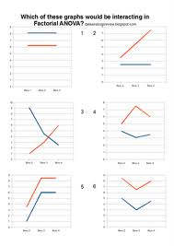
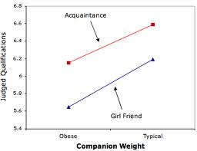

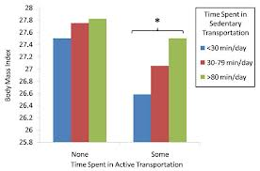
The Effects of a Research Methods Course on Psychology Students’ Anxiety Levels
Stu Dent, Iman A. Student, & Do Well
Sponsored by Dr. _________, spring/fall 20____
Abstract
Materials
Results
Type your abstract here. About 150 words is the usual limit.
Use the same abstract that you prepared for your written research report. This is the only section that can remain unchanged. The abstract may also be printed in smaller font.
Your abstract will be printed in the Program Book; so, spend some time on it.
Describe your stimuli, questionnaires, etc. You can scan questionnaires into jpegs and post them here.
Introduction
We averaged across exemplars for each participant for each question in each condition. Averaged ratings were submitted to three 2-way factorial ANOVAs.
Type your Introduction here.
The introduction or rationale will probably need to be scaled back from the one you prepared for the written report. Aim for mostly the gist of your rationale; but don’t forget to include the purpose and significance of your study and your hypotheses. You will also need some research literature. Here are some ways to highlight applicable literature:
Discuss the first study to address your topic in its current form. Then describe a very relevant recent one, especially if you are replicating and extending it. There may be more than one very similar to yours; mention the most similar.
Discuss the competing theoretical positions surrounding your work. Then describe the study that most resembles your method.
Provide a general explanation without references about how this problem has been addressed traditionally in research. Then explain, with references if appropriate, how you will diverge from this tradition and why.
Keep the introduction as short as possible; try to stay within the textbox size on the templates provided. If there is pertinent information that you want your audience to read, make it visually distinct from the rest. You can accomplish this by using bullets, frames, bold italics, or color.
Describe your graphs and tables. What statistical tests did you perform? What did you find?
Procedures
Conclusions
Describe your procedures here.
Include your research design, variables, etc.
Describe your graphs and tables. What statistical tests did you perform? What did you find?
Instead of a discussion, posters usually have conclusions. The difference is that conclusions are less speculative and more directly tied to the hypothesis and results. There is no room for implications or suggestions for future research.
Include a “take home message”, which is the one point about your study readers should take away with them.
Participants
References
Instead of using a single Methods section, you can divide it into various sections such as Participants, Materials, Procedure, and Design.
If you referred to other people’s work, you will have to develop a reference section. Use APA-style formatting for the references.
Describe your graphs and tables. What statistical tests did you perform? What did you find?

