Slide 1


Taylor’s
Taylor Hall Council Presents: Social Program of the Year

Slide 2

Table of Contents:
Cover…………………………………....…………………………………………1
Table of Contents………………...………………………………………...…....2
Goals…………………….…………………..………………………………...….3
Budget…………………….……………………………..……………………......4
And the Winners are?……………...………………………..…...…………......5
Letter of Support…………………………………………..……………………..6

Slide 3
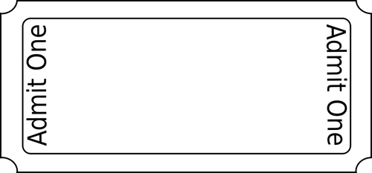
Goals
With this program, we wanted the residents to come out and socialize with each other while watching other residents perform. We planned this program at the beginning of the school year because it was one that a lot of people would enjoy. Surprisingly, residents from Thomas Hall and Lawson Hall came to listen with their friends from Taylor. We had performers who sang, played instruments, danced and solved rubik's cubes. Another goal for this program was to bring people out of their comfort zones and to meet other Taylor residents. This program was a hit because we had a lot of residents and performances in attendance.

Slide 4
Budget
When planning this program, we discussed what we wanted to put into the program and what we needed to order. With every program we plan, we have to think about the future of hall council and our plans. To execute out plans of having a successful program, the only things that we needed to order were gift cards for the winners and snacks for the audience to eat while watching the performers. We did not spend much on this program, but the money that was put into the program was given back to the winners of Taylor’s Got Talent.

Slide 5

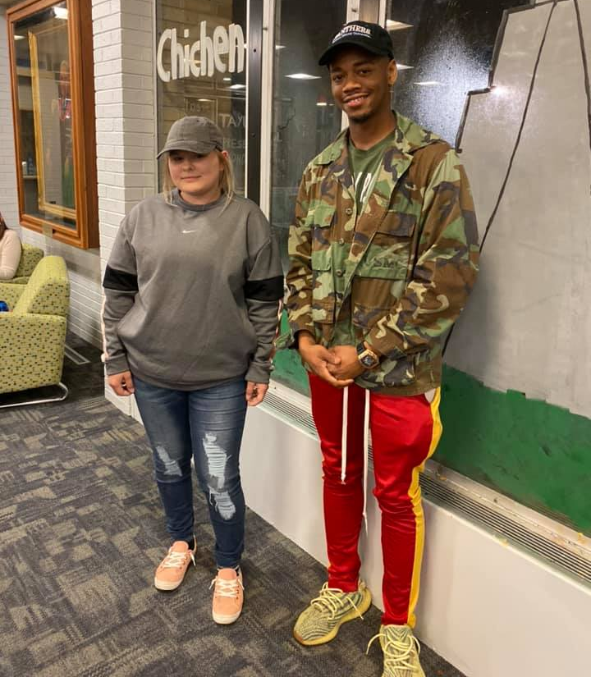
AND THE WINNERS ARE...
Cassie (Singing) and Armani (Singing and Playing Guitar)
Cassie and Armani had solo performances. Cassie sang a over from Adele and Armani sang a self written song and played guitar for the audience. They were the talk of Taylor Hall because of their performances. Cassie and Armani are very talented performers. At many times during the semester, you could hear hard work being put in from Cassie and Armani in the piano room.

Slide 6
Letter of Support
Taylor’s Got Talent was one of our biggest programs for the year. I was happy to see many different residents come out to see their friends perform and vote for them. The residents and other building staff enjoyed themselves while watching the performances. I am proud of how Taylor’s Got Talent turned out and I believe that it should be a program that should be put on every year.
Hall Council wanted to come up with a program where we knew a lot of different groups of people would come out to. This ended up happening with the help of strategically planning how we would get residents to come by using incentives like prizes and snacks, creating flyers that told the residents what was happening and using word of mouth.
Taylor’s Got Talent should be put into high consideration because of the talent of the Taylor Residents and the talent of the Hall Council members to put on a program like this.
Taylor Hall Council President, Mia Melendez

