Slide 1
Making Media Inclusive
Across Grade Levels and Disciplines
Notes:
Please think about this question as you view the rest of this slideshow. If you are able, you are welcome to chat with a peer on social media.

Slide 2
Opening Question
How might you incorporate inclusive media in your classrooms to meet your disciplinary needs?
Pair Share and Discuss
Notes:
Please think about this question as you view the rest of this slideshow. If you are able, you are welcome to chat with a peer on social media.

Slide 3
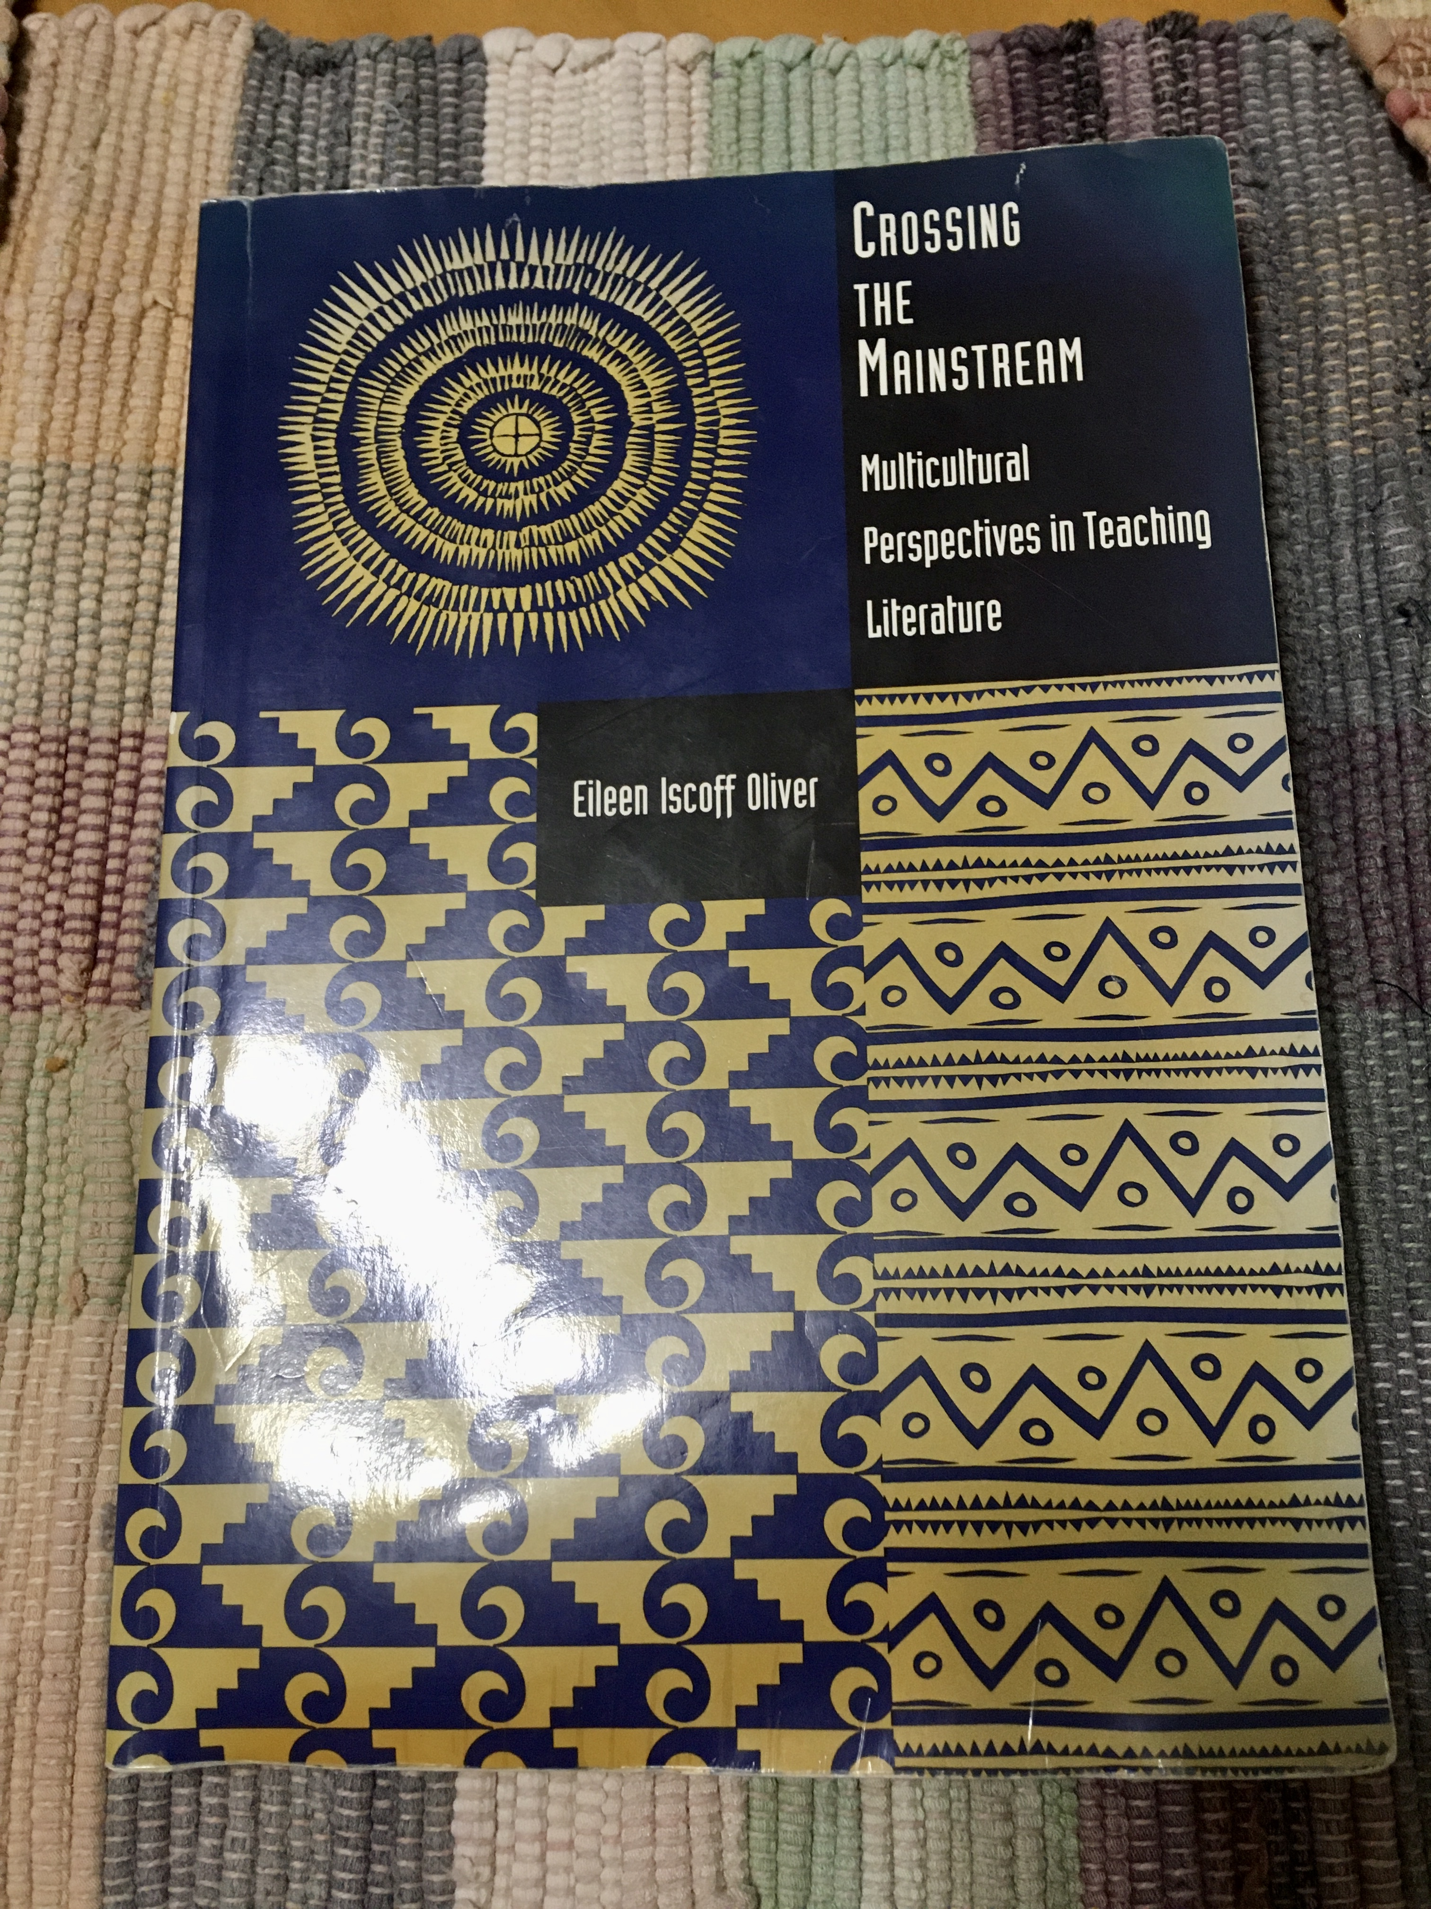
Notes:
Many approaches to "making media inclusive" align with approaches explored in literature classes. This NCTE text from years ago offers effective methods for incorporating multicultural literature in secondary classrooms--Crossing the Mainstream, indeed.

Slide 4
“The Right Rules for the Right Game” Approach
“One of the problems with expanding our [media] canon to include multicultural perspectives is that we must also expand the criteria with which we judge” (Eileen Iscoff Oliver, Crossing the Mainstream: Multicultural Perspectives in Teaching Literature, 134).
“To look more critically at the literatures [and media] of the United States… we must broaden our knowledge of characteristics of … excellence beyond the traditional Eurocentric models that we have been educated with and continue to teach in our classrooms. Traditional elements such as plot development, characterization, use of symbolism, and so forth simply may not be relevant when we study the literature [and media] of nonmainstream writers. Thus, we may be undervaluing the aesthetic quality of nonmainstream work simply because we do not know what to look for” (Oliver 137).
Notes:
One of the key principles for crossing this mainstream highlighted is a "right rules for the right game" approach. This approach stresses the need to read diverse literature and media in relation to not only the cultural background of the texts, but also the literary and media history underpinning the works.

Slide 5
Multicultural Does Not Mean Multiethnic (Oliver 63)
According to Oliver, Bonnie Davis discovered that her first graders “did display certain biases in their perceptions with disabilities” (67).
Biklen and Bodan and Margolis and Shapiro suggest we need to recognize stereotypes in texts to address them in ourselves.
They also suggest that “characters with disabilities should be integrated in a positive way with others” (Oliver 68).
Notes:
The text also stressed the need to move beyond viewing multicultural literature through a limited number of lenses--race and ethnicity. The quotes included from the text here highlight issues connected with ableism.

Slide 6
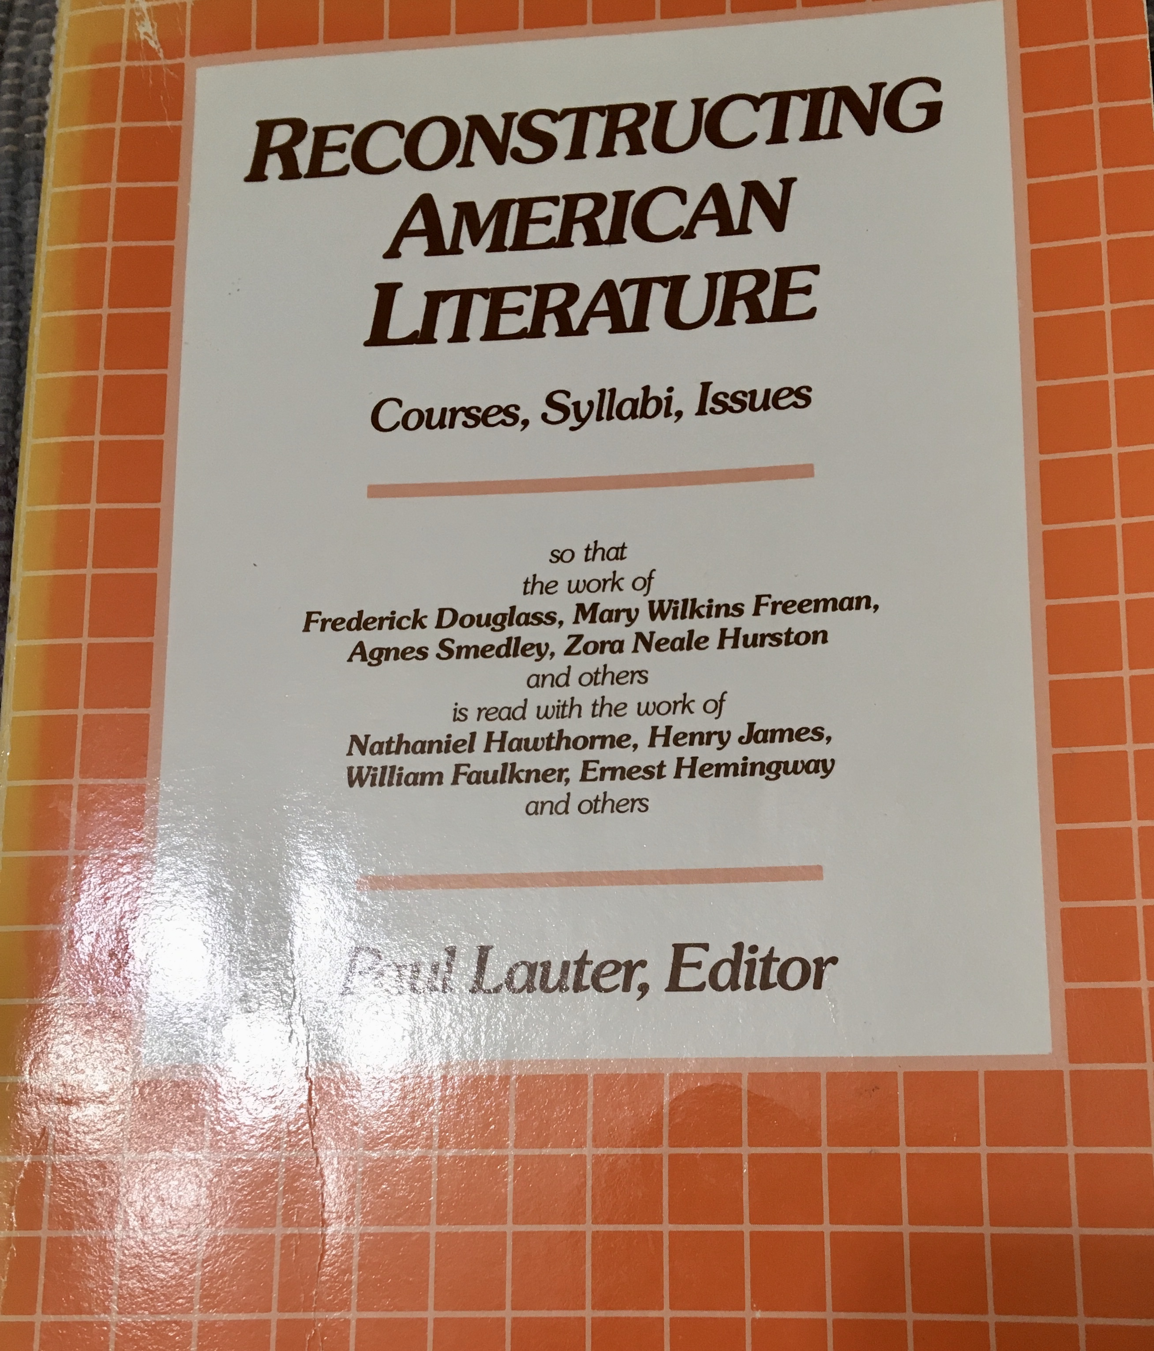
Notes:
An earlier text from Paul Lauter, Reconstructing American Literature, emphasizes a conversational approach to literature that could also apply to media.

Slide 7
A “Canons and Contexts” Approach from Paul Lauter
“Critics have continued to focus on a severely limited canon of "major" writers based on historical and aesthetic categories from this slightly augmented mainstream.”
“The problem we face is that the model is itself fundamentally misleading. The United States is a heterogeneous society whose cultures, while they overlap in significant respect, also differ in critical ways.”
“What we need, rather, is to pose a comparative model for the study of American literature. …. only what we might call 'comparative American studies" will lead us out of the distortions and misunderstandings produced by the mainstream and tributary framework.”(Lauter)
Notes:
Lauter takes a "Canons and Contexts" approach like that he and his co-editors stress in the Heath Anthology (ies) of American Literature.

Slide 8
Canons and Contexts, Continued
“An advantage of a comparative model is that it allows us to discard the notion that ll literatures … must be viewed through the lenses shaped to examine mainstream—that is, largely white and male—culture. We can then begin to see that, for example, subjects and forms invoked by African American writers are influenced not only by the traditions of Anglo-European literature but by indigenous folk and formal cultures of black communities in the United States and elsewhere”
Notes:
Please see this long quotation from Lauter about the advantages of this approach and think about how it might apply to media analyses.
For our purposes, I have chosen a set of diverse Young Adult Films that demonstrate this conversational approach.

Slide 9
DVDs Showcasing Diverse Young Adult Film and Video
American Honey (2016): https://smile.amazon.com/American-Honey-Blu-ray-Digital-HD/dp/B01LTHWY42/ref=sr_1_2?keywords=American+Honey&qid=1572981587&s=movies-tv&sr=1-2
The Fits (2016): https://smile.amazon.com/Fits-Royalty-Hightower/dp/B01G2J0U9I/ref=sr_1_3?crid=2V2ZICNRYUU7M&keywords=the+fits+dvd&qid=1572981691&s=movies-tv&sprefix=the+fits%2Cmovies-tv%2C160&sr=1-3
Madeinusa (2006): https://smile.amazon.com/Madeinusa-Carlos-Torre/dp/B000MGBLV4/ref=sr_1_1?keywords=Madeinusa+dvd&qid=1572981842&s=movies-tv&sr=1-1
Salvation Army (2015): https://smile.amazon.com/Salvation-Army-Said-Mrini/dp/B00Q3CYDL6/ref=sr_1_1?keywords=salvation+army+dvd&qid=1572981902&s=movies-tv&sr=1-1
Youth (2017): https://smile.amazon.com/Youth-Chinese-movie-English-Subtitles/dp/6819904037/ref=sr_1_1?keywords=Youth+2017+dvd&qid=1572981967&s=movies-tv&sr=1-1
Notes:
More films!

Slide 10
Mustang (2015): https://smile.amazon.com/Mustang-Gunes-Sensoy/dp/B018WKM75K/ref=sr_1_2?keywords=mustang+dvd&qid=1572982088&s=movies-tv&sr=1-2
Ginger and Rosa (2013): https://smile.amazon.com/Ginger-Rosa-Annette-Bening/dp/B00CMCCAHK/ref=sr_1_1?keywords=Ginger+and+Rosa+dvd&qid=1572982124&s=movies-tv&sr=1-1
Theeb (2015): https://smile.amazon.com/Theeb-Jacir-Eid/dp/B01B74D202/ref=sr_1_1?keywords=Theeb+dvd&qid=1572982159&s=movies-tv&sr=1-1
Notes:
And more films!

Slide 11
Wadjda (2012): https://smile.amazon.com/Wadjda-DVD/dp/B00GDEZKZC/ref=sr_1_1?keywords=Wadjda+%282012%29&qid=1573070766&s=movies-tv&sr=1-1
Samson & Delilah (2009): https://smile.amazon.com/Samson-Delilah-Rowan-Mcnamara/dp/B004326F50/ref=sr_1_1?keywords=Samson+%26+Delilah+%282009%29&qid=1573070852&s=movies-tv&sr=1-1
He Named Me Malala (2015): https://smile.amazon.com/He-Named-Me-Malala-Yousafzai/dp/B0176IELOY/ref=sr_1_3?keywords=He+Named+Me+Malala+%282015%29&qid=1573070925&s=movies-tv&sr=1-3
Tomboy (2011): https://www.amazon.com/Tomboy-Sophie-Cattani/dp/B007OXB1H2/ref=asc_df_B007OXB1H2/?tag=hyprod-20&linkCode=df0&hvadid=312241836172&hvpos=1o3&hvnetw=g&hvrand=8878684348837285183&hvpone=&hvptwo=&hvqmt=&hvdev=c&hvdvcmdl=&hvlocint=&hvlocphy=9022250&hvtargid=aud-801381245258:pla-554395712604&psc=1
Notes:
More Films!

Slide 12
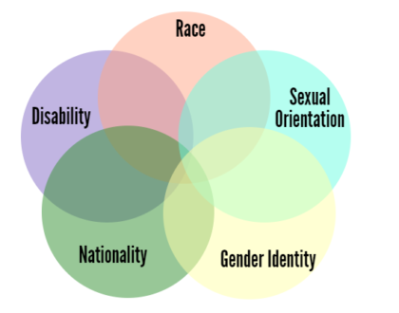
An Intersectionality Approach
Notes:
Another approach, intersectionality, stresses not only conversations between but also within texts and individuals. Although this section will explore intersectionality and its history and applications, it will flesh out an under-emphasize part of this theory--disability studies.

Slide 13
Intersectionality in Context
Kimberlé Crenshaw, law professor and social theorist, first coined the term intersectionality in her 1989 paper “Demarginalizing The Intersection Of Race And Sex: A Black Feminist Critique Of Antidiscrimination Doctrine, Feminist Theory And Antiracist Politics.”
Intersectionality, n.: The interconnected nature of social categorizations such as race, class, and gender, regarded as creating overlapping and interdependent systems of discrimination or disadvantage; a theoretical approach based on such a premise. (Oxford Dictionary)
Intersectionality is a framework for conceptualizing a person, group of people, or social problem as affected by a number of discriminations and disadvantages. It takes into account people’s overlapping identities and experiences in order to understand the complexity of prejudices they face.
Notes:
Please note Kimberle Crenshaw's 1989 paper where she coined the term intersectionality in 1989.

Slide 14
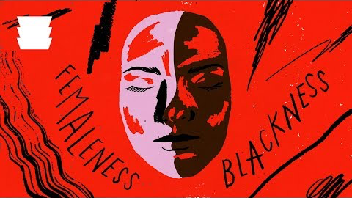
Intersectionality in Context, continued: https://youtu.be/X5H80Nhmn20
Notes:
Take a look at this video, "A People's Journey...." from the National Museum of African American History and Culture.

Slide 15
Confronting Ableism: A Less-Emphasized Element of Intersectionality
“It is no longer acceptable to not have women at the table. It is no longer acceptable to not have people of color at the table,” disability activist Judy Heumann writes. “But no one thinks to see if the table is accessible.” Road Map
According to Heumann, “The media is at a crossroads. Diversity is in the zeitgeist and disability is being left out of the conversation. One in four Americans is disabled, and they should be represented proportionally in front of and behind the camera.”
“According to GLAAD’s Where We Are on TV ’18-’19, only 2.1 percent of primetime broadcast TV series regulars—or a total of 16 characters—have disabilities. A recent Annenberg study found that, across the 100 top-grossing movies of 2016, only 2.7 percent of characters were depicted with a disability, only 2.5 percent of characters were depicted with a disability over the past 10 years, and nearly half of the films across the top 100 did not include a single character with a disability. Of those small numbers of characters, 95 percent are played by non-disabled actors on television” (Heumann 1).
What Hollywood Gets Wrong About Disabilities (Robyn Powell)
Notes:
As disability activist Judy Heumann demonstrates, confronting Ableism in the media requires a road map like that she outlines in the white paper linked in the slide.
Please also see Robyn Powell's article in the final link.

Slide 16
Stereotypical portrayals of disability
A. THE SUPER CRIP
Examples:
1. Daredevil in the Daredevil TV series
2. Professor X in the X-Men film series
3. Jaime Sommers in The Bionic Woman TV series
Super Crips are disabled characters who triumph over their disability. At face value, this may seem like a positive stereotype: Who doesn’t want to be seen as a hero? Daredevil overcomes his blindness to become a badass superhero who defeats the bad guys. He is a superhero despite his disability. But the Super Crip stereotype reinforces the idea that disability is something that must be overcome. Super Crips tends to appear in “inspiration porn,” because they’re portrayed as being inspirational by virtue of prevailing over their disability. (Heumann 3)
Notes:
In her white paper written for the Ford Foundation, Judy Heumann explores stereotypical portrayals of disability still prevalent in the media.
Note the Super Crip example--can you think of others?

Slide 17
B. THE VILLAIN
Examples:
1. The villains in most James Bond movies, including You Only Live Twice, Golden Eye, Casino Royale, Die Another Day, and Skyfall
2. Darth Vader in Star Wars
3. The Joker in The Dark Knight
4. Voldemort in the Harry Potter movies
5. Dr. Poison in the Wonder Woman movie
This stereotype plays on people’s inherent discomfort with those who do not look the same as them, telling them that disfigurement—and disability, in general—makes characters revolting and morally wrong and reinforcing the notion that “we should be afraid of people whose faces and bodies are different from our own.” (Heumann 3)
Notes:
Villains like these seem to be the most prevalent stereotypical roles found in media.

Slide 18
C. THE VICTIM
Examples:
1. Will Traynor in Me Before You
2. Maggie Fitzgerald in Million Dollar Baby
3. Elisa Esposito in The Shape of Water
Disabled characters are often portrayed as one-dimensional victims of their disability. Their disability becomes their defining feature and their lives revolve around it, rendering them failures and objects of pity. Movies like Me Before You and Million Dollar Baby depict disability as an insurmountable hurdle, and a disabled life as not worth living, presenting suicide as a better option. (Heumann 3)
As HuffPost reporter Elyse Wanshel recently explained, “The Shape of Water” conveys the message “if you don’t fit into society, it’s better that you leave.”
Notes:
But victims also prevail, even in critically acclaimed films like The Shape of Water.

Slide 19
THE INNOCENT FOOL
Examples: Raymond in Rain Man
Characters with intellectual disabilities are often portrayed as childlike, unable to make rational decisions for themselves and needing to be cared for by others. They’re presented as unavoidably constrained by their circumstances and often are seen as people to laugh at, or as the butt of jokes. (Heumann 4)

Slide 20
Notable Exceptions from Heumann’s Study:
“Representation of disability in the media should be one in four, in front of and behind the camera, in characters, in actors, in directors, in writers’ rooms, and more. Disabled people come in all shapes and sizes, from wheelchair riders to people with psychosocial disabilities to those with chronic illnesses. From the Hispanic deaf person to the legally blind African American who has albinism to the Asian lesbian wheelchair rider, diversity is intersectional and the media must reflect this. Not only do disabled people need to see themselves, but their families and communities need to see disability on their screens. Most people acquire their disabilities as they become older, so people should be given the opportunity to learn about the diversity in this community.” (Heumann 2)
Notes:
Although, as Judy Heuman explains, "representations of disability in the media should be one in four, in front of the camera, in characters, in actors, in directors, in writers' rooms, and more," the exceptions to the stereotypes highlighted here provide a little hope.

Slide 21
Exceptions, Continued:
“We are seeing small changes. There are now primetime shows such as Speechless, which features a young, physically disabled actor playing a lead character with a disability.
Switched at Birth gives the audience a small peek into deaf community and culture.
Sesame Street (which has been on the air for 49 years with more than 1,400 episodes,) introduced a puppet character with a disability in 2017, and the character of Julia, who has autism, was highly celebrated and accepted.
Breaking Bad is considered by some to be one of the best dramas ever on television, and the main character’s son has cerebral palsy and is played by an actor with that disability.” (Heumann 2)

Slide 22
Drunk History Example
“One of the best examples of disability representation was a recent Comedy Central Drunk History episode highlighting the Section 504 demonstrations in 1977 that eventually led to the Americans with Disabilities Act in 1990. It was part of a collection of stories focused on civil rights activists, from suffragettes to African Americans in the South, demonstrating how each group simply wanted access to equal citizenship. Every disabled character in the episode was played by a disabled actor and it illustrated an actual event in disability history, one that is seldom discussed in mainstream media.” (Heumann 2)
https://www.facebook.com/drunkhistorytv/videos/judy-heumann-fights-for-people-with-disabilities/1543374245775406/
Notes:
I love this Drunk History exploration of Judy Heumann's fight for the Americans with Disability Act.

Slide 23
With These Constraints in Mind…
How can we make media in our classrooms more inclusive?
How can we confront ableist stereotypes in our classrooms?
What media would you suggest as positive portrayals of people with disabilities?
What images of people with disabilities have you seen in the media and might integrate into your own classroom?
Notes:
Now think about questions like these for you own classrooms.

Slide 24
DVDs Highlighting Positive Portrayals of People with Disabilities
On a Roll: http://www.jojobeanyhead.com/nonfiction.html (Dir. Joanne Caputo, 2004)
Lives Worth Living: (Dir. Eric Neudel, 2011) http://storylinemotionpictures.com/purchase-a-dvd/
Poetry (Dir. Lee Chang-Dong, 2011): https://www.amazon.com/Poetry-Blu-ray-Yoon-Jeong-hee/dp/B0053TWVW8/ref=asc_df_B0053TWVW8/?tag=hyprod-20&linkCode=df0&hvadid=312241836172&hvpos=1o8&hvnetw=g&hvrand=13322690723251298866&hvpone=&hvptwo=&hvqmt=&hvdev=c&hvdvcmdl=&hvlocint=&hvlocphy=9022492&hvtargid=aud-801381245258:pla-568373550646&psc=1
Autism the Musical: (Dir. Tricia Regan, 2008) https://www.amazon.com/Poetry-Blu-ray-Yoon-Jeong-hee/dp/B0053TWVW8/ref=asc_df_B0053TWVW8/?tag=hyprod-20&linkCode=df0&hvadid=312241836172&hvpos=1o8&hvnetw=g&hvrand=13322690723251298866&hvpone=&hvptwo=&hvqmt=&hvdev=c&hvdvcmdl=&hvlocint=&hvlocphy=9022492&hvtargid=aud-801381245258:pla-568373550646&psc=1
Mary and Max: (Dir. Adam Elliot, 2010) https://www.amazon.com/Mary-Max-Toni-Collette/dp/B00366E1E6/ref=tmm_dvd_swatch_0?_encoding=UTF8&qid=1571844682&sr=1-2
Notes:
And look for media representations like these (and those found in the DVDs)

Slide 25
The Color of Paradise: (Dir. Majid Majidi, 2000) https://www.amazon.com/Color-Paradise-Mohsen-Ramezani/dp/B00004VVO5/ref=sr_1_2?keywords=the+color+of+paradise&qid=1571844753&s=movies-tv&sr=1-2
The House is Black (Dir. Forugh Farrokhzad, 1963) https://www.amazon.com/House-Black-Forugh-Farrokhzad/dp/B00074CC50
Murderball (Dir. Henry Alex Rubin, 2005): https://www.amazon.com/Murderball-Joe-Soares/dp/B000B5XP24/ref=sr_1_1?keywords=Murderball&qid=1571844930&s=movies-tv&sr=1-1
The Little Girl Who Sold the Sun (Dir. Djibril Diop Mamb ty) https://www.amazon.com/Franc-Little-Petite-vendeuse-soleil/dp/B000V2LOHU/ref=sr_1_1?keywords=the+little+girl+who+sold+the+sun&qid=1571845868&s=movies-tv&sr=1-1
Life, Animated (Dir. Roger Williams, 2016) https://www.amazon.com/Life-Animated-Owen-Suskind/dp/B01KNCHQVA/ref=sr_1_2?keywords=life+animated&qid=1571846032&s=movies-tv&sr=1-2
Children of a Lesser God (Dir. Randa Haines) https://www.amazon.com/Children-Lesser-God-William-Hurt/dp/B074J5X1JV/ref=sr_1_1?crid=3GVIOWSDFOLD5&keywords=children+of+a+lesser+god+dvd&qid=1571846091&s=movies-tv&sprefix=children+of+a+lesser+god%2Cmovies-tv%2C168&sr=1-1

