Slide 1
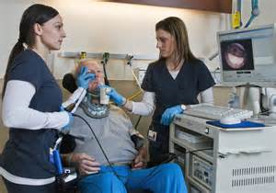


Speech-Language Pathology
(speech therapy)

Slide 2
Please edit, delete, or add any slides or information in the presentation to make it work for you.
Thank-you for doing the presentation at your school!

Slide 3
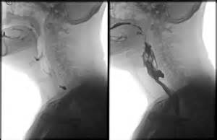

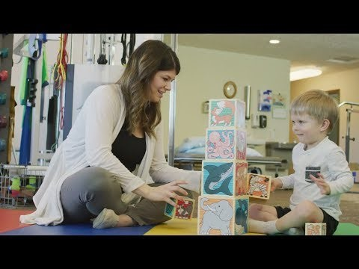

A Career as a
Speech-Language Pathologist
What DOES An SLP do?
SLPs work with individuals with communication disorders & swallowing disorders such as:
Autism
Speech sound disorders
Spoken language delays
Augmentative and Alternative Communication (AAC)
Reading and writing difficulties
Aphasia (typically following strokes, word finding and other difficulties)
Feeding & swallowing disorders
Traumatic brain injury and other cognitive communication disorders
Stuttering
Voice disorders due to head and neck cancer, vocal nodules, and more
Hearing impairments (may work with children needing cochlear implants, hearing aids, who use sign language, total communication, or oral only communication)
(What Does an SLP Do? Video 1 min 30 sec)
Notes:
My (Beth Bergstrom) current caseload at EIU: I have developmental trauma x 2, Cleft palate x2, High functioning autism x2, autism, feeding disorders x 2, oral motor dysfunction – clinic setting ages 1-80
I began in a nursing home in FL, moved to school in Bethany, Hospital (did early intervention, inpatient, outpatient, home health, EIU
What is your current setting and caseload? Val and Kam

Slide 4

A Career as a
Speech-Language Pathologist
WHAT ARE THE REQUIREMENTS TO BE AN SLP?
Need a bachelor’s degree in Communication Disorders & Sciences or Speech & Hearing Science (or required set of undergraduate courses with a different undergraduate degree)
Then need a master’s degree from an ASHA CAA accredited speech pathology graduate program
Pass the National Speech-Language Pathology Praxis exam for licensure and certification.
(Note: Universities offer very different experiences in the major. EIU has undergraduate clinical experience, high acceptance to grad school, back-up plans, full-time 14-week internships in BOTH the school and medial setting in graduate school, very high scores on national exam, and much more)

Slide 5



A Career as a
Speech-Language Pathologist
Where do SLPs WORK?
SLP in Hospital Video
Approximately 40% work in some type of health care setting
  Hospitals, residential health care setting, out-patient clinic, home health care
Approximately 50% work in the school setting
  preschools, elementary schools, middle schools, high schools
Approximately 10% work in Early Intervention (Birth-3 population), universities, or other settings.
You can work in any or all of these at one time (part-time/hourly) or make changes over the course of your career (e.g. work in a school when you have kids who are school-age, work in EI or residential healthcare after school or summers)
SLP in School Video
SLP in Early Intervention
Private Practice Video

Slide 6
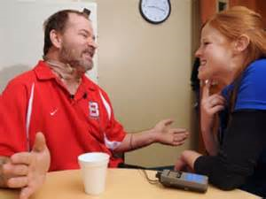
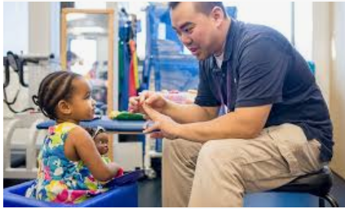

What’s the Job Outlook? Will there be jobs?
GREAT JOB OUTLOOK!
100% Employment- you can find a job! Often multiple job offers
Top Ten Jobs in 2020, US News & World Report
  #6 for health care jobs, #8 of ALL jobs
SLP job opportunities growing 27% between 2018 and 2028 (Bureau Labor Statistics)- much faster than average GROWING profession

Slide 7


Show me the MONEY –
What are salaries like for speech-language pathologists?
2019 US Bureau of Labor Statistics Reports
Median Salary for SLPs was $79,120
Factors Influencing SLP Salaries
9 or 10 months in schools versus 12 months per year in medical settings
Salary rates with benefits, hourly PRN part-time rates
Rural vs Urban, need/degree of shortages, and cost of living
Years of experience, clinical service provider vs supervisor/administrator

Slide 8
Speech-Language Pathology Salary
Working 9-10 months in School Setting
(ASHA 2020 School Survey)
Working 12 months in Medical Setting
(ASHA 2019 Health Care Survey)
Median salary with 1-5 years experience was $56,000
Median salary with 10-20 years experience was $70,000
Higher median salaries in urban compared to rural settings ($70,000 vs $60,000)
Median part-time hourly pay (rather than salary & benefits) was $50-55 per hour
Median salary with 1-3 years experience was $66,000
Median salary with 19 + years experience was $83,000-$100,000
Median salary clinical service provider $74,000, for admin/supervisors $100,000
Median part-time hourly pay (rather than salary & benefits) was $50 per hour

Slide 9
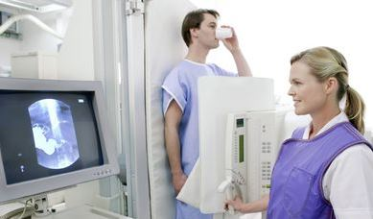
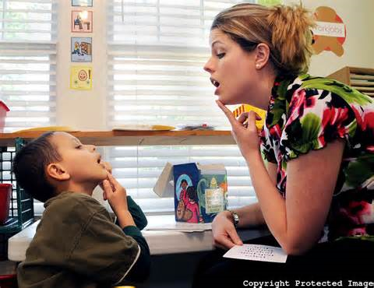
TOP 5 reasons to be an SLP
LOVE GOING TO WORK EVERY DAY to HELP people and make a difference in their lives.
Flexibility – choose a job that’s part-time, full-time, 9 months, 12 months. Choose one main job, add PRN hourly if you want.
Never get burned out- if you are tired of one setting/population or age group, CHANGE jobs. Jobs are available and will be in the future with growth anticipated. Opportunities in administration.
Often part of a TEAM in health care or school setting, but usually have a lot of autonomy and independence too.
  5) Good salary or hourly rates
Other great things about Being an SLP……

Slide 10

Want to be an SLP?
Join the Department of Communication Disorders & Sciences at Eastern Illinois University
(SLP requires master’s degree)

Slide 11
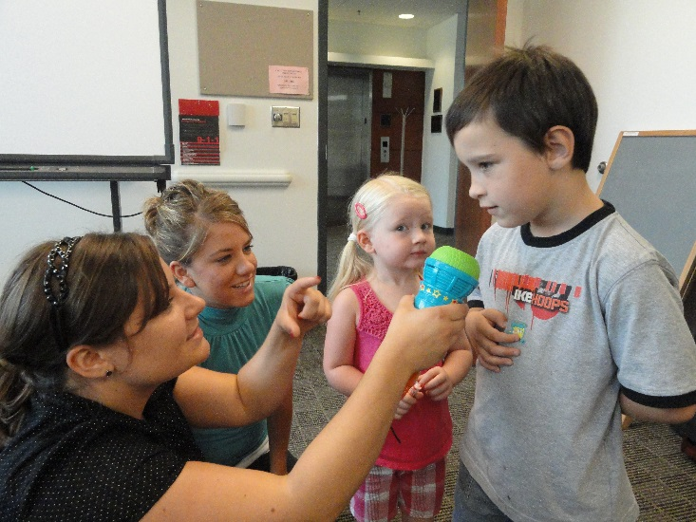

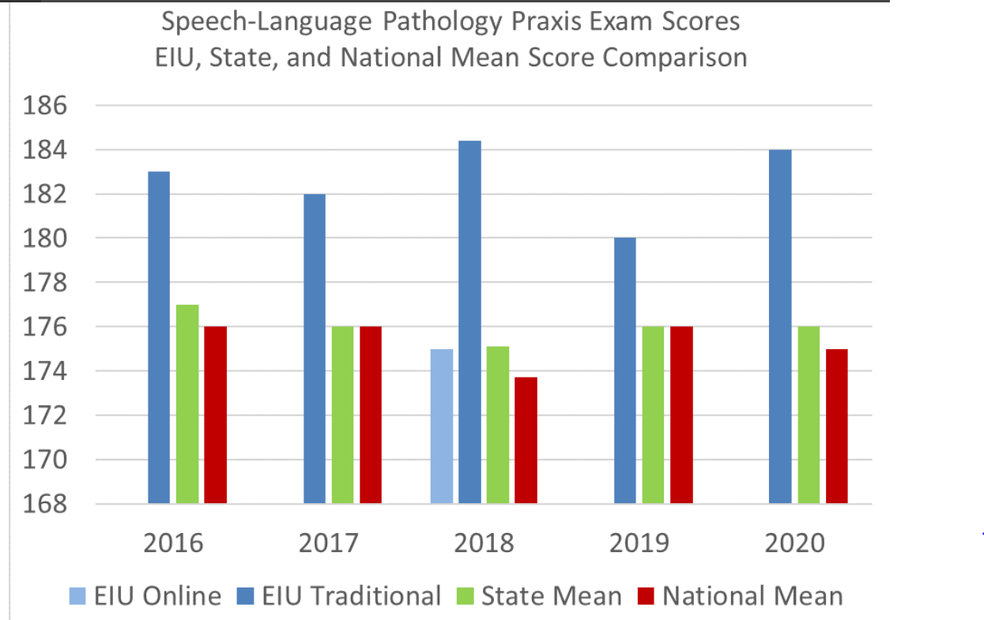
WHY STUDY COMMUNICATION DISORDERS & SCIENCE AT EIU?
Friendly department, faculty have open doors and like to know students. Faculty member is your advisor.
ONLY Illinois public university where undergraduate students get to help with a client and then treat their own client.
Classes are functional, taught by faculty who worked as SLPs for years before coming to EIU.
Great opportunities outside of class- honor’s program, volunteer with Autism Center, study abroad/therapy abroad, bilingual group, NSSHLA student group activities.
High acceptance to Grad School. Back up plans.
Graduate School- Full-time 14-week internships in BOTH medical setting AND school setting. High scores and passing rate on national certification test.

Slide 12
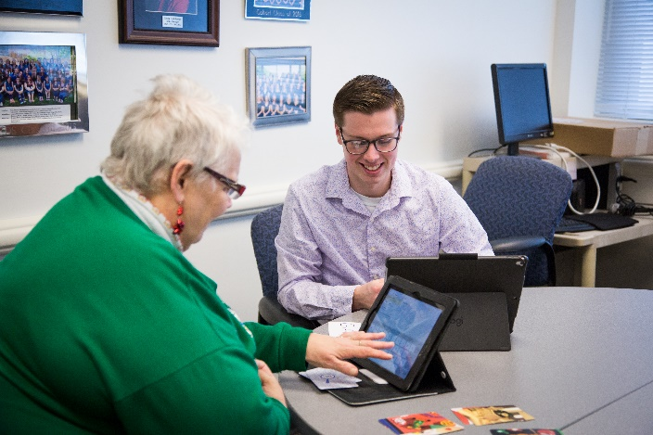


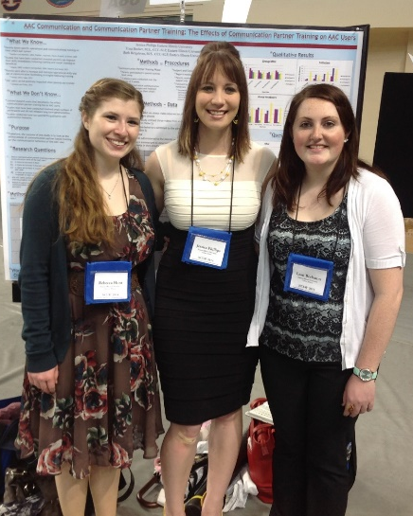
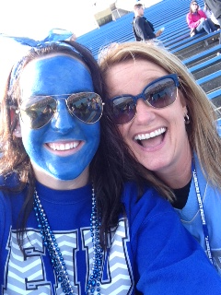
CONSIDER CDS AT EIU for Speech Pathology
Come to the department. Meet students and visit with faculty.
Check out: https://www.eiu.edu/commdis/index.php for visit days and more information work with adults, work with kids, travel abroad, do research, make memories

Slide 13
OPTIONAL ACTIVITIES
Speech language pathologists (and audiologists) may work with children or adults with hearing impairment
This hearing loss simulator lets you hear what people with a mild, moderate, or severe hearing loss can hear of a conversation in quiet conditions, in a car, and other conditions like with music playing or in a crowd.
https://www.starkey.com/hearing-loss-simulator/simulator

Slide 14
Optional Activity – Working with Adults with Aphasia after a Stroke
What does it feel like to not be able to understand/process some of what is being said?
http://aphasiacorner.com//aphasia-simulations/listening-impairments-simulation-2.html
Reading difficulties
http://aphasiacorner.com//aphasia-simulations/reading-impairments-simulation-1.html
Word finding and word errors
http://aphasiacorner.com//aphasia-simulations/speaking-impairments-simulation-1.html

Slide 15
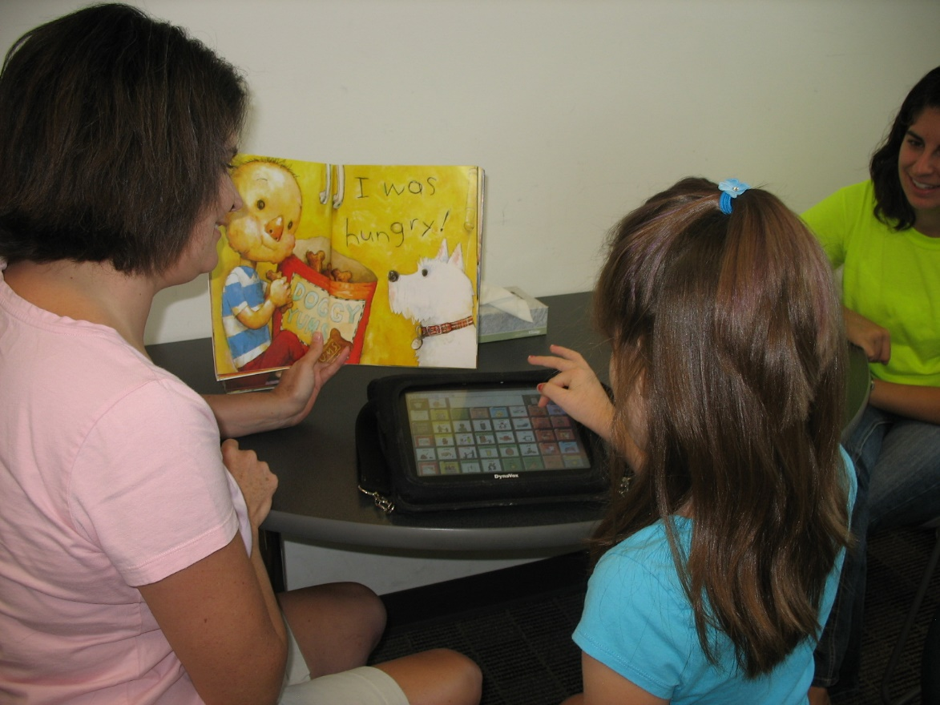
Optional Activity - Forms of Communication
Talking and Listening
Writing and Reading
Sign language and visual processing of the signs
Augmentative and alternative communication (AAC) – one type picture communication

Slide 16
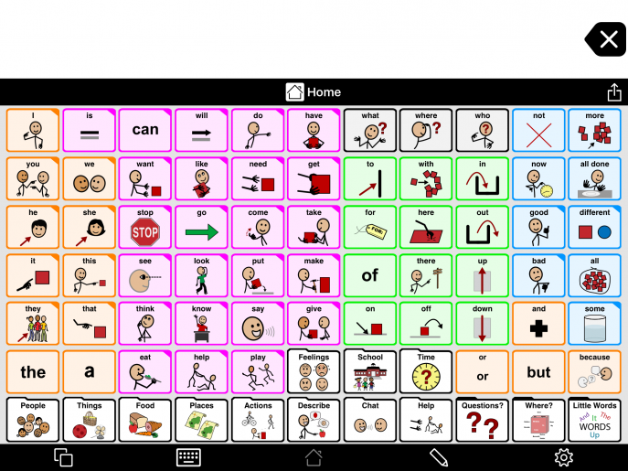
Notes:
Find symbols to communicate-
I go to school.
I want some more (pizza- food category)
Help me up

