Slide 1

Grounded in the Storm: Mindfulness for Advisors
Misty Rhoads Ph.D., LHC., CZB., MBSR
Advising Symposium
February 2026

Slide 2
What Is Mindfulness and Why Are We Using It at EIU?
Mindfulness is the capacity to pay attention, on purpose, in the present moment, without judgment. It is the ability to feel more calm and centered as things come at us and to have more internal space to deal with things.
At EIU, we are using mindfulness because:
Burnout is real.
Students are arriving more anxious and more dysregulated.
Advisors are carrying invisible emotional labor.
And regulation is teachable.

Slide 3

The Nervous System Ladder
Ventral Vagal
  (Safe & Connected)
Middle of the Ladder
  Sympathetic (Fight or Flight)
Bottom of the Ladder
  Dorsal Vagal (Shutdown)
  Locating Ourselves on the Ladder
  Glimmers

Slide 4

Why Mindfulness Matters in Advisor Roles
When we are regulated, we have:
Greater cognitive flexibility
Better executive function
Increased empathy
When a student trauma-dumps:
Your nervous system activates.
You feel urgency.
You may feel overwhelmed.

Slide 5

Co-Regulation: Why Your Regulation Matters
Advisors and faculty- I can’t say it enough we are the nervous system of the university. It takes a regulated nervous system to co-regulate a dysregulated one.
Co-regulation is the process of supporting another’s nervous system through your presence, attention, and physiological steadiness. Your eyes, tone, facial expression, and your energy field. You do not fix problems. You influence safety through what you embody.

Slide 6

Co-Regulation Practices Advisors Can Use
Regulate before you respond
Ground through your feet
Slow the pace
One rung vs the whole ladder
Micro reset between students

Slide 7
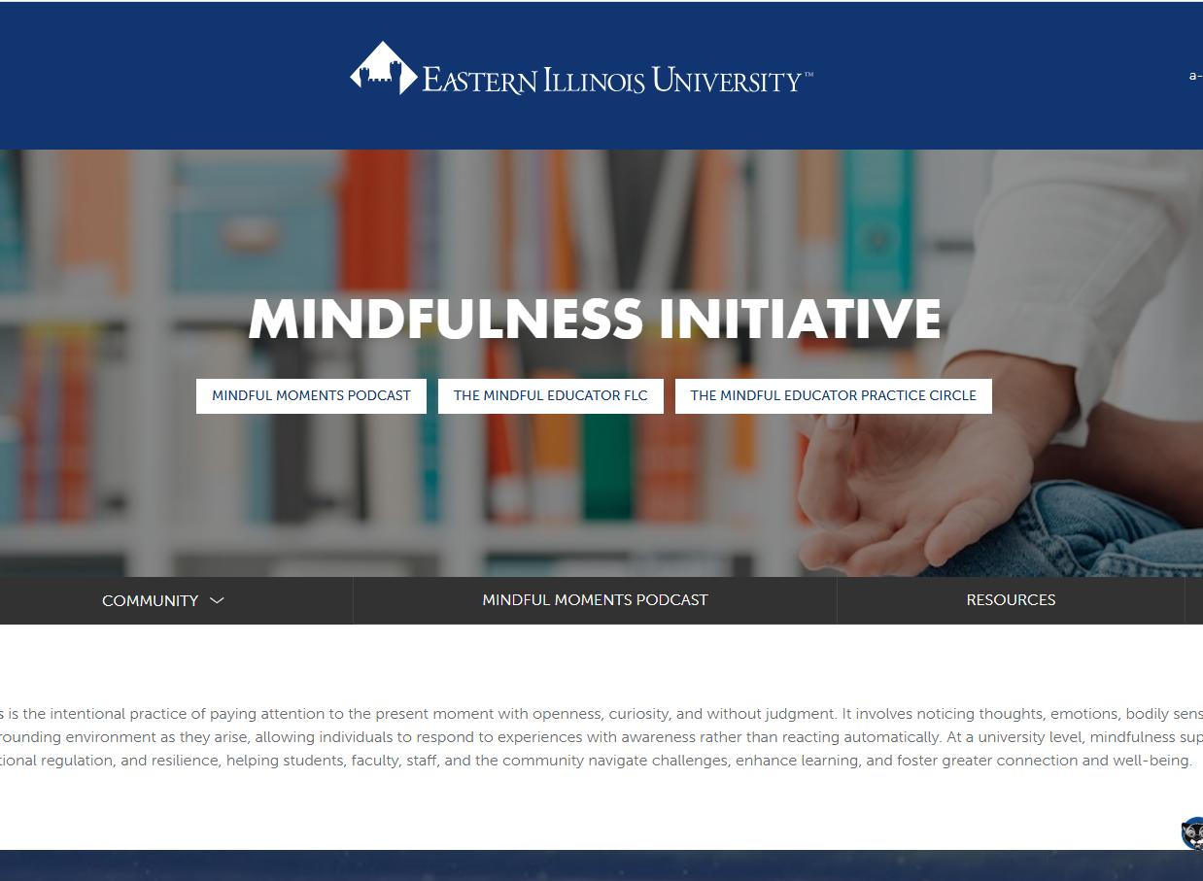
Mindfulness Initiative
Continued support
https://www.eiu.edu/mindfulness_initiative/

