Slide 1

Electronic Student Files
Mary “Sam” Laingen
University Pre-Health Professions Advisor

Slide 2

Student Files
Why electronic files?
Creating Files
Accessing SharePoint
Accessing OneDrive
Utilizing Student Files
  Finding Files
  Creating Sub Folders
What and How to put items in the file
Q&A

Slide 3

Why are electronic files needed?
Save Time
  Students, Faculty, & Staff
Save Space
Facilitate Communication
Provide Consistency

Slide 4
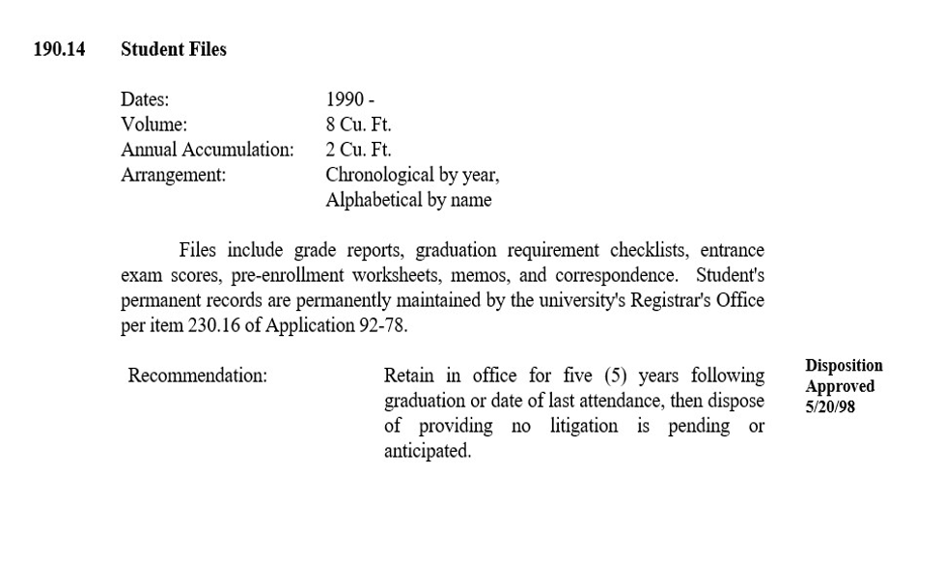


State Guidelines for Required Student Files
These files are the official university student file and must be maintained per the state set guidelines (just like paper files)
They should NOT be deleted by advisors

Slide 5



Creating Files
Official Files are created in the Academic Advising Center (just like paper files)
  If you create your own files, move content to the official file once you gain access
Official Files are Labeled:
  Last Name, First Name, E#
  followed by admission code
    ST (Standard Admit)
    GW (Gateway Admit)
    TR (Transfer Admit)
    INT for International Admit
    NUR (Nursing Admit)
Doe, Edith E12345678 ST
Doe, Kenneth E12345679 TR
Notes:
Just like paper files used to be

Slide 6
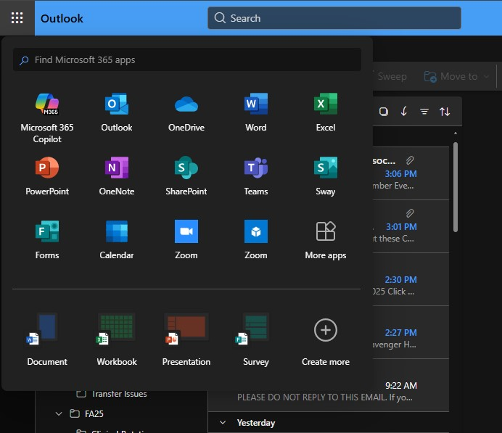
Accessing Student Files through SharePoint
Go to the EIU Homepage
Click on Panthermail to open Microsoft 365
Click on 9-dots arranged in a box in upper left corner – Select SharePoint or More Apps (Search for SharePoint)
All files are housed on SharePoint and can be accessed through OneDrive
(Like a giant file room just like paper files)

Slide 7
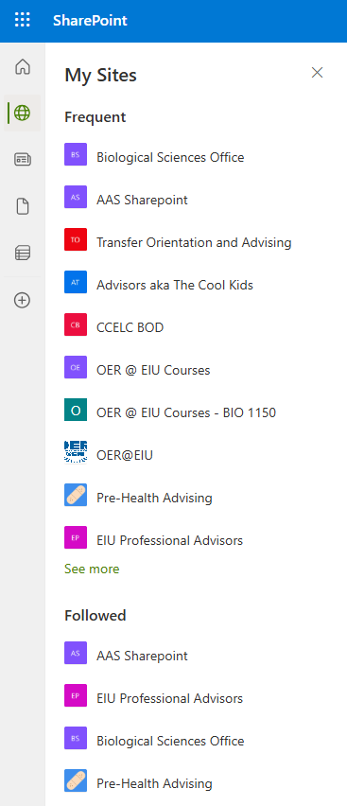
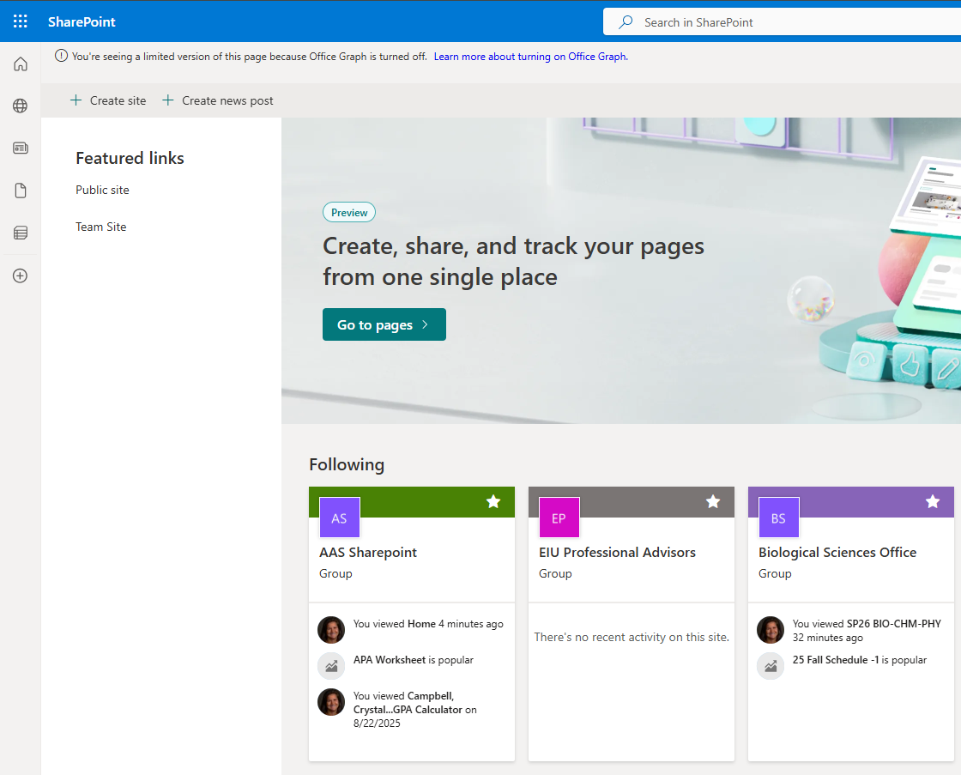
SharePoint Tips
Bookmarking a SharePoint
Navigate to the SharePoint link you received in your email and click Sign in with your EIU credentials if needed
Click on the name of the SharePoint folder
Be sure to click the star icon in the top right to follow the SharePoint
Once you do, you will always be able to return to the SharePoint from anywhere in your Microsoft account by clicking the menu icon (9-dots arranged in a box), then SharePoint icon

Slide 8
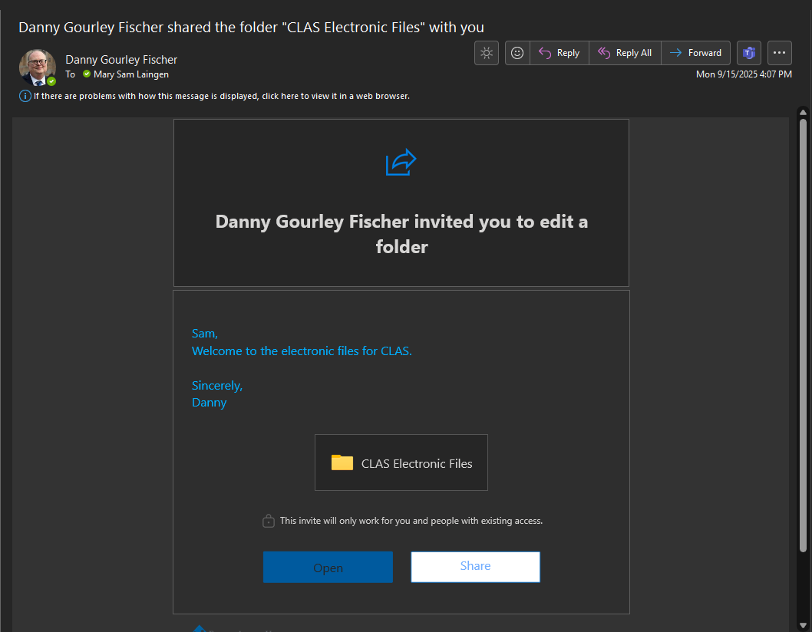
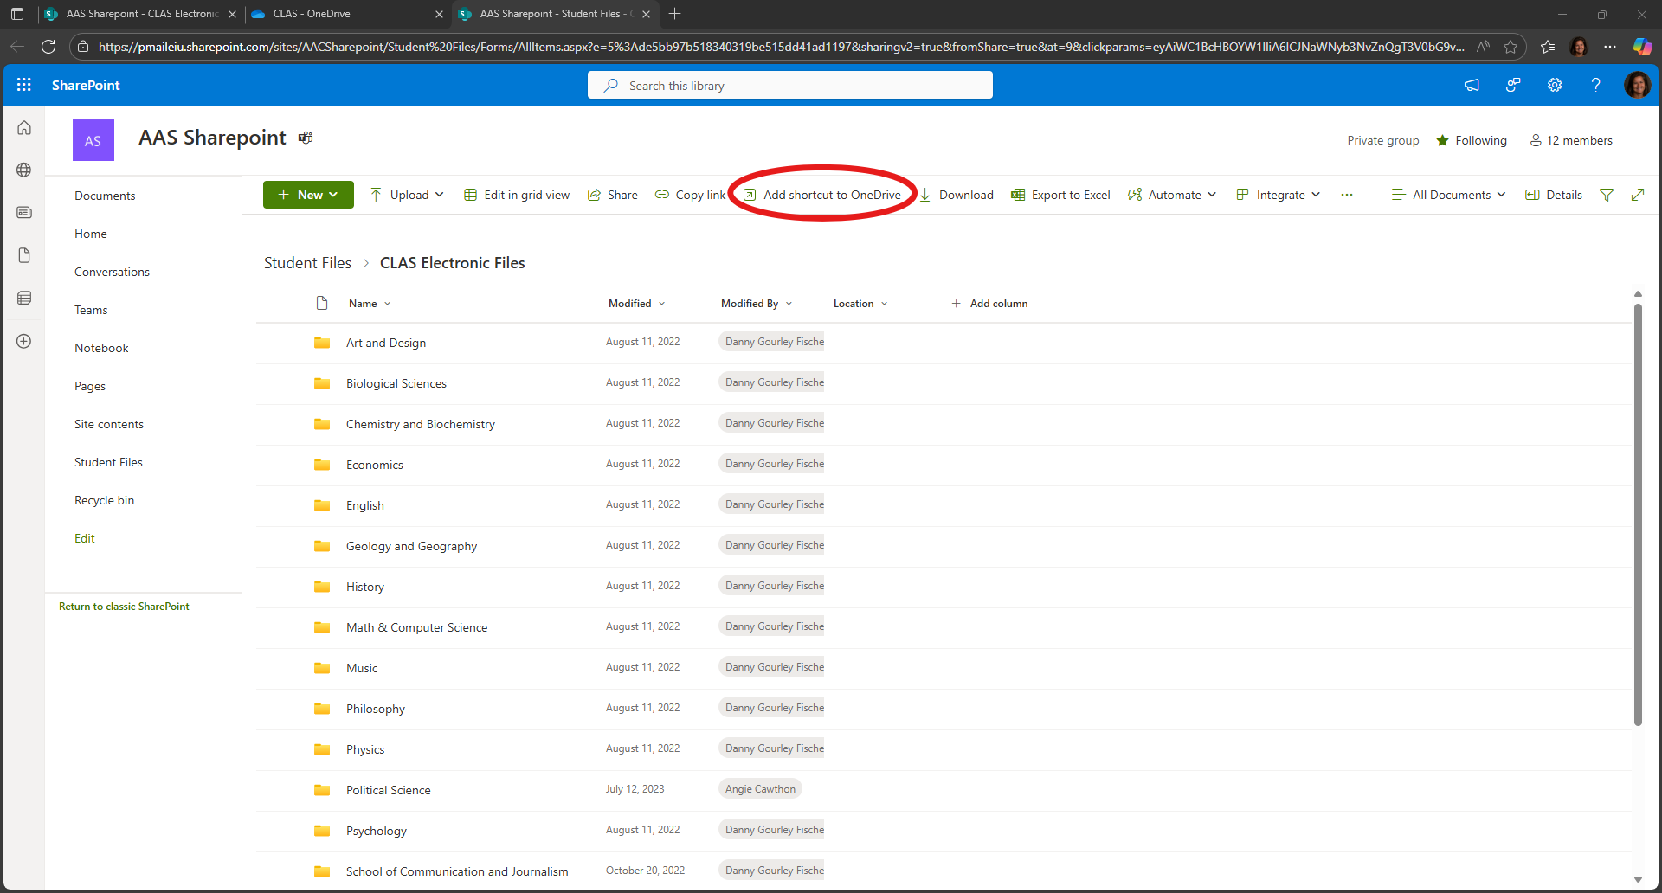
Accessing Student Files through SharePoint then OneDrive
Look
Look for an email from Danny Gourley Fisher: “Danny Gourley Fischer shared the folder _____________ with you”
Click
Click on the File icon to open the SharePoint location
Click
Click “Add shortcut to OneDrive”

Slide 9
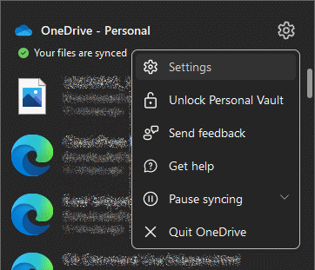
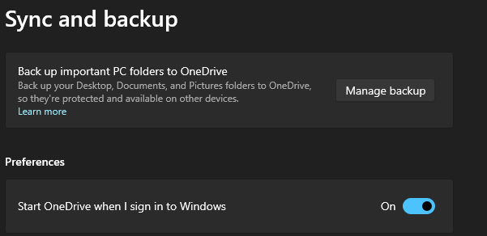

OneDrive Tips
Synching Files with OneDrive
Look for the cloud icon in the System Tray at the bottom right of your screen.
If it is not there, go to the Windows menu, search for OneDrive, click on it to run it
  Wait about 60 seconds
Right-click the cloud icon, click the gear icon, click Settings
Click Sync and backup and be sure the “Start OneDrive when I sign in to Windows” is in the ON position

Slide 10

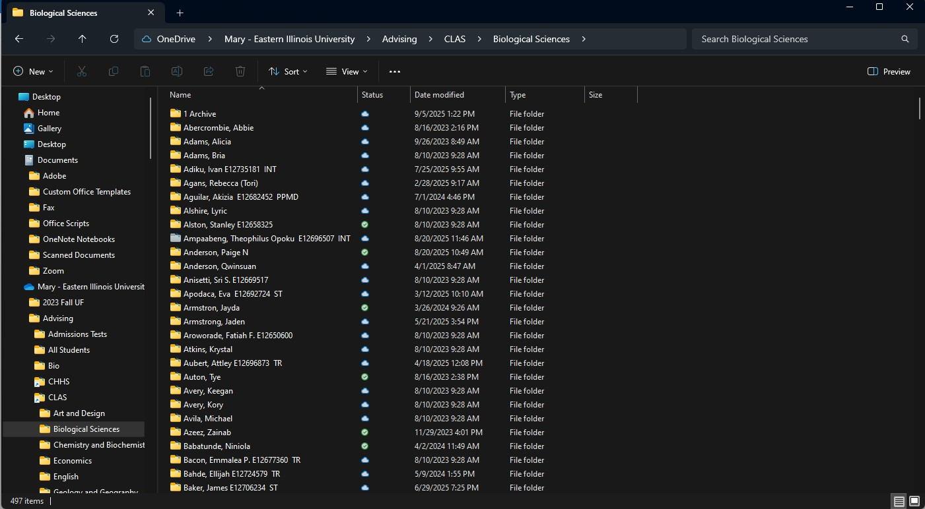
Finding a Student File
Use the Search Bar – It’s the easiest way to find the file
(and you do not have to sing the ABC’s to help)
Notes:
Just like paper files used to be

Slide 11
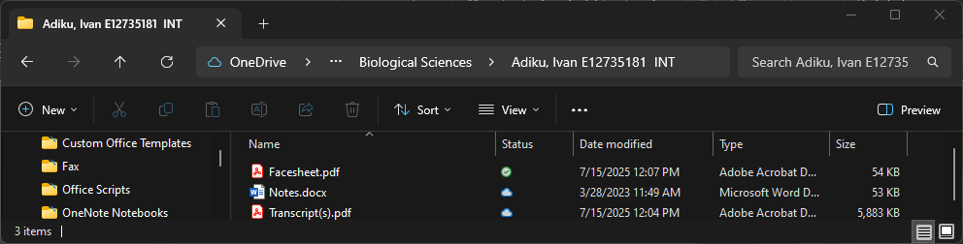
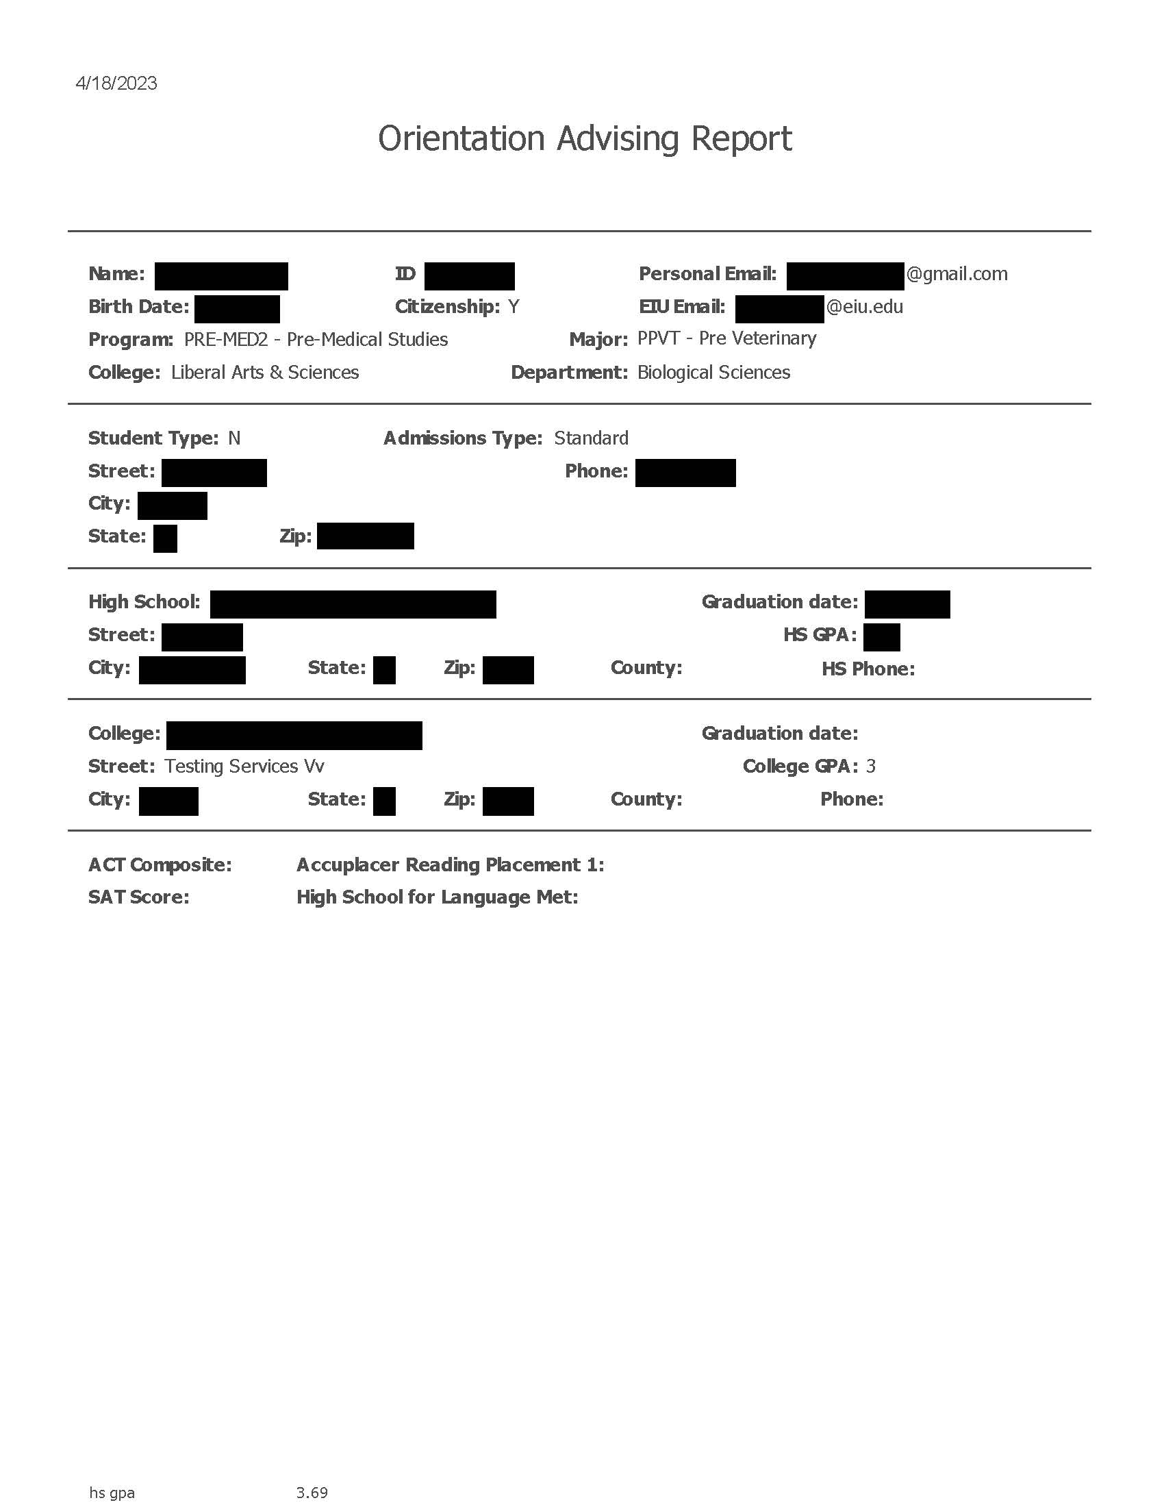
What’s in the Student File?
Student Transcripts
  As of the date the file was created
    vs searching on Banner: SAAADMS
Notes
  Word document where advisors can write notes
Facesheet
  Created for advisors
  Basic Student Information
  High School Information (Including GPA)
  College Information (Including GPA)
  Test Scores

Slide 12
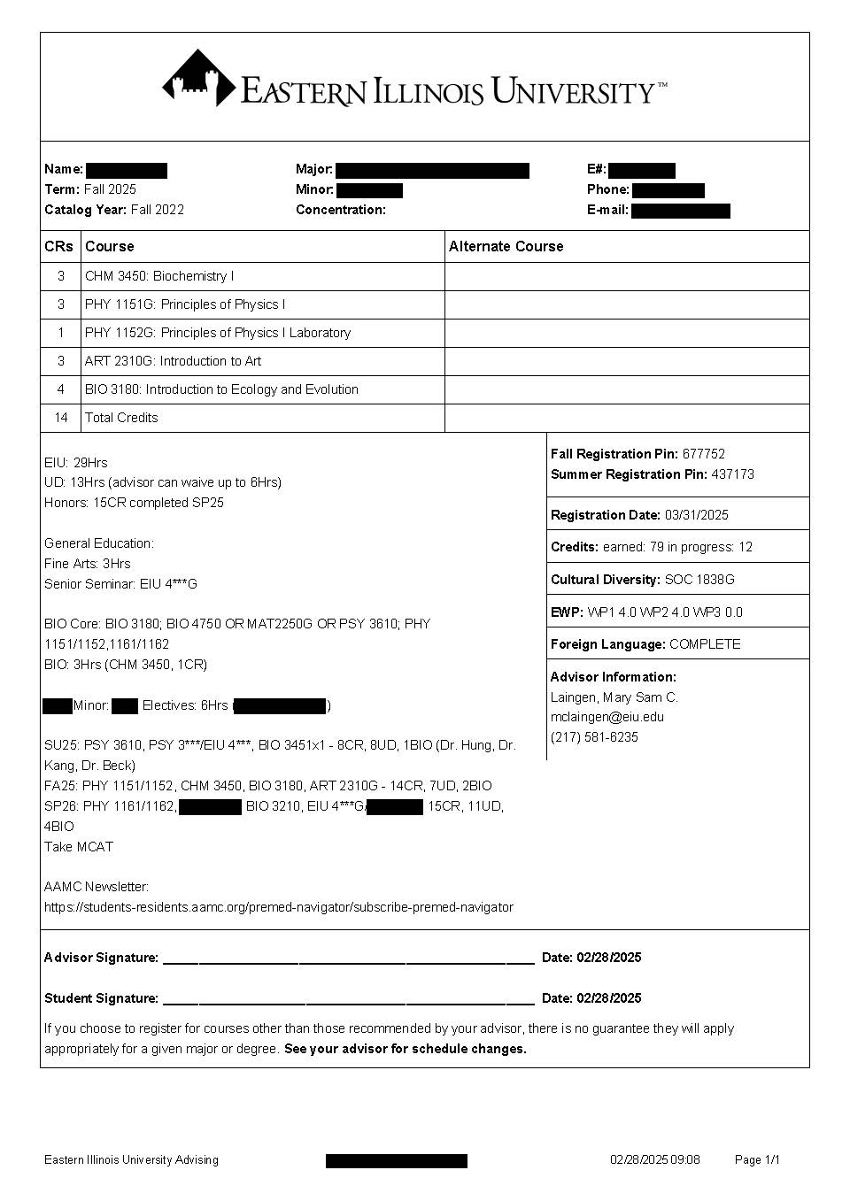

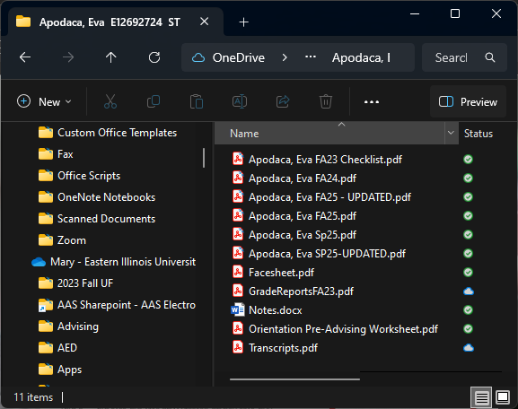
What should advisors put in the file?
Advising Worksheets – PLEASE!
ANYTHING you want to keep to document information related to that student
Grade sheets/reports
SAP appeals
Major/Minor Checklist
Updated Test Scores
Updated Transcripts
Emails
Just like Paper Files
Waivers
  Shows suggested courses and suggested alternates
  Allows for notes
  Documents several degree requirements
    Credits completed/in-progress, EWP submission, World Language Req, Cultural Diversity Req
  Can be accessed by other advisors

Slide 13
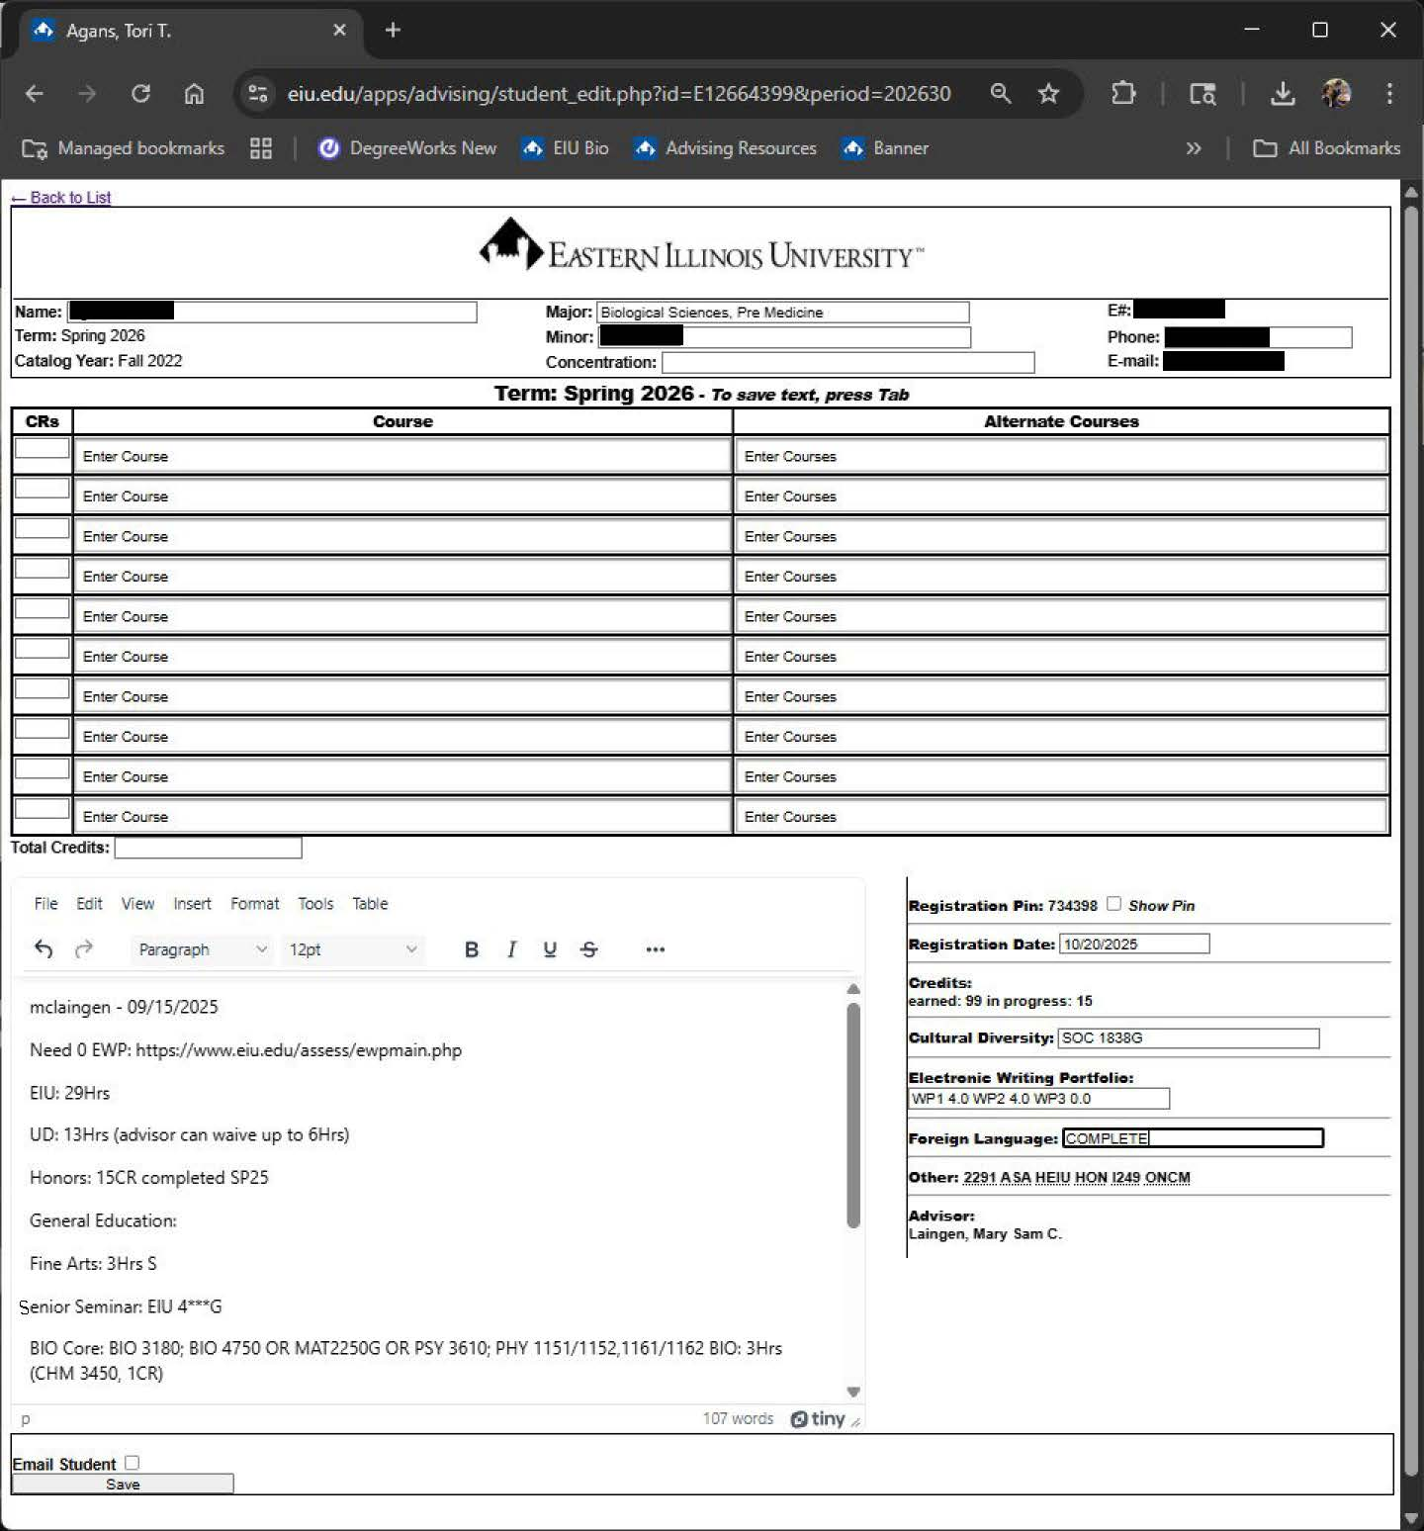
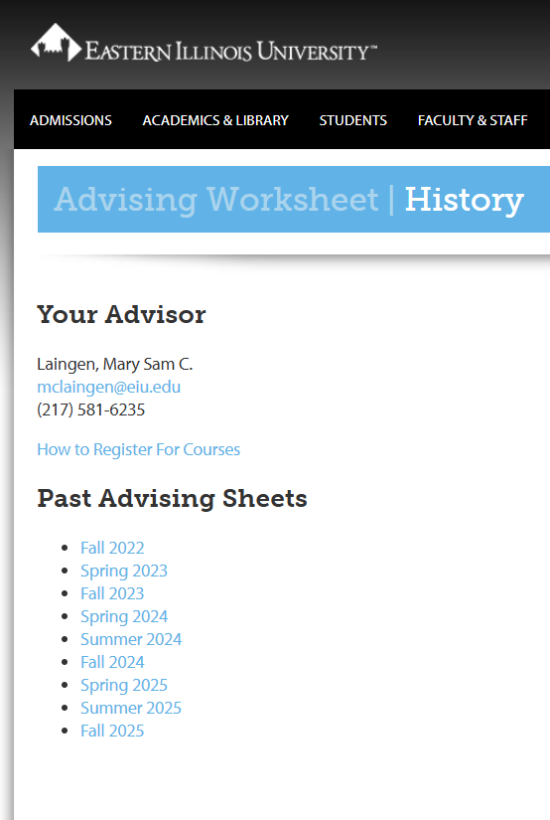
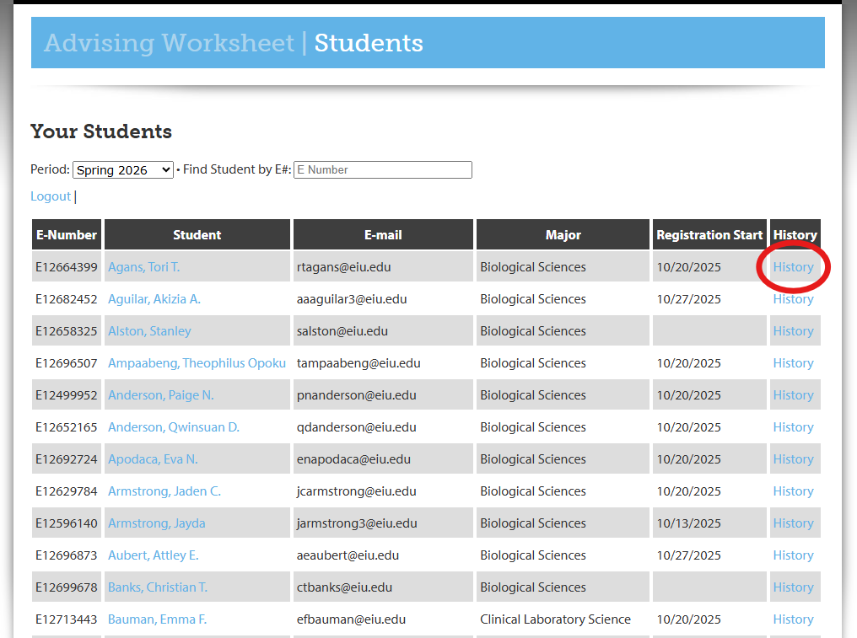
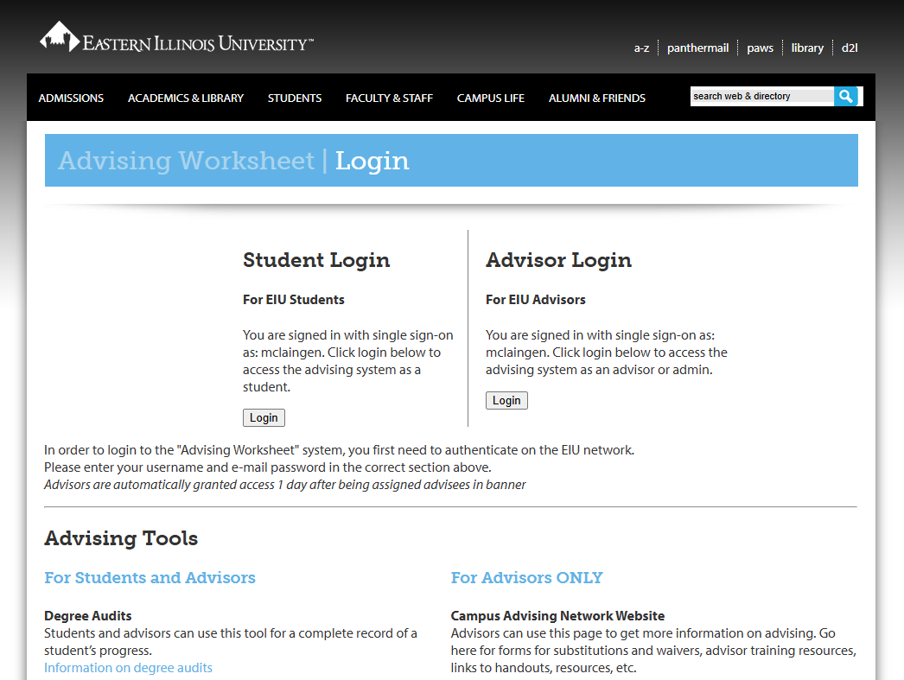
Advising Worksheets Quick Tutorial
Access through CAN Website: Resources for Advisors: Advising Worksheet
Click on “History” to access previous semesters
  Can copy previous notes to paste into current semester sheet
Select Advisee by name or search by E#
Enter courses and alternate courses
Add notes regarding EWP reminders, scheduling issues, possible waivers, degree planning, resources and links
Select “Email Student” and “Registration PIN” to send to student automatically
Click Save – Automatically generates a PDF to print and save

Slide 14
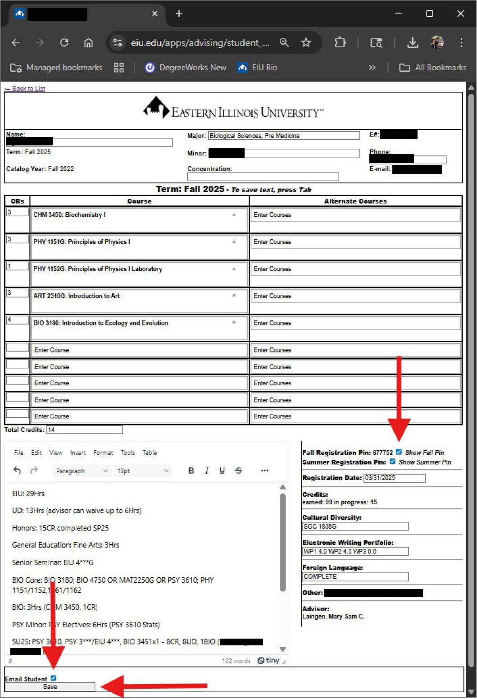
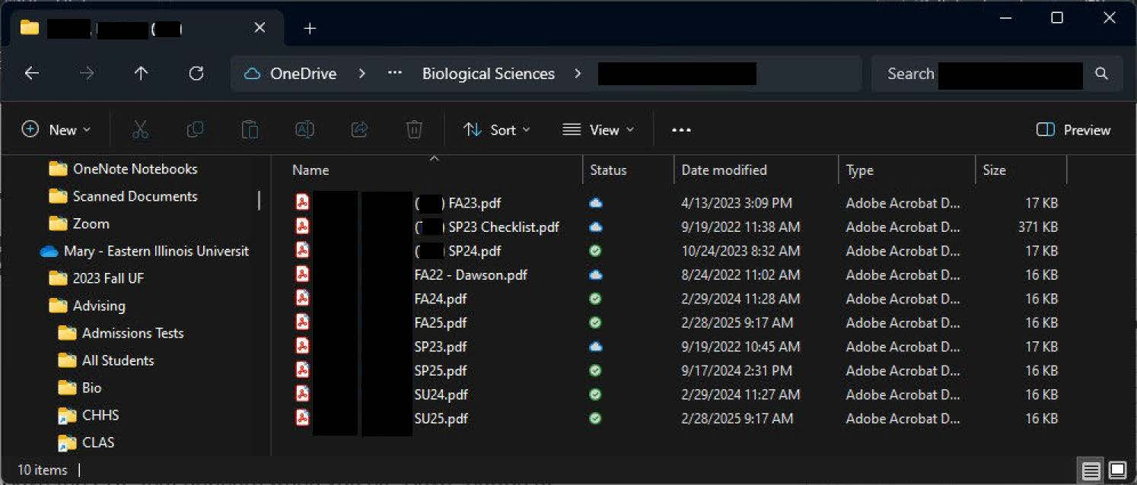

How to save advising worksheets to electronic Student Files
Fill in the advising worksheet during the student appointment
Check the box to email student and/or show PIN
Click “Save”
Save the PDF that appears when you hit “Save” button at bottom left corner in the students file (just like printing a copy and adding to paper file)
  Click the download icon in the upper right corner
  Save in student’s official file as “Last Name, First Name, Semester, Advisor Name (if applicable), UPDATE # (if necessary)
Advising Management only saves the most recent copy
  If someone else edits or deletes your previous notes, no record of previous notes
Click on “History” to access previous semesters

Slide 15
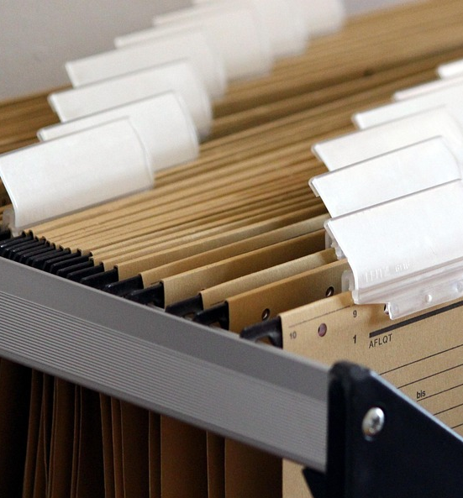
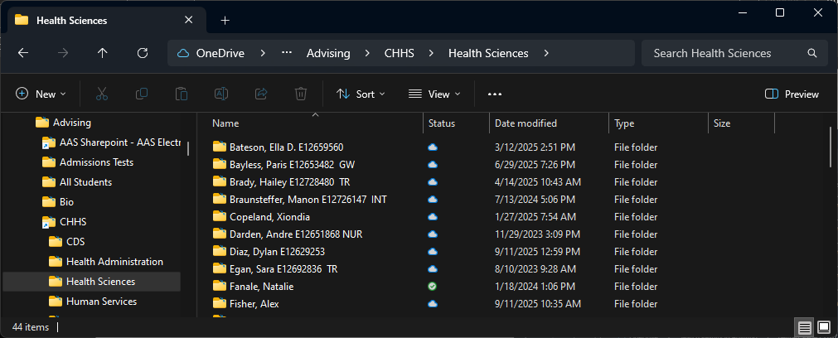
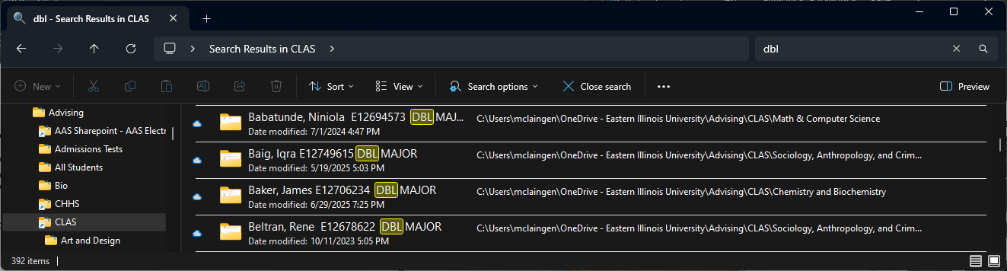
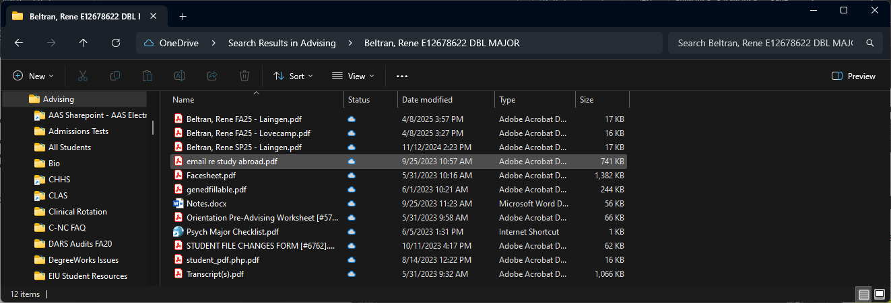
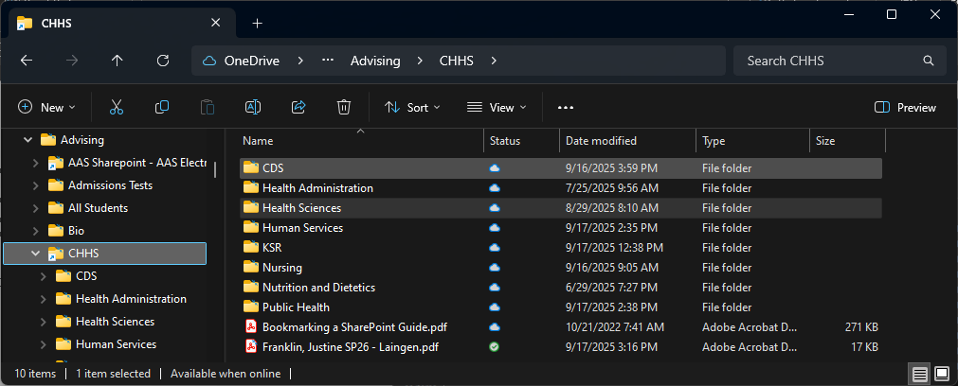
Duplicate Student Files
Double Major
File name ends in DBL MAJOR (just like paper files)
If a student is a double major in English and History:
  DBL MAJOR ENG in the English Department File
  DBL MAJOR HIS in the History Department File
If you have a reason for creating your own files:
Create a sub folder or temporary file
If you create files in the main folder
  Ensure the file name is different from the Official File, i.e. no E#, include advisors name
  If a student changes majors, the Degree Certification Officer needs to move the official file to the new major’s department folder
All new files created by AAC will be placed in the department’s folder (just like paper files without moving stacks of files across campus)

Slide 16



What about graduated (or inactive) students?
Advisors should NOT delete files from SharePoint
Move student files to “Inactive” file once student graduates
  Even if the student is inactive, leave in the main file
    If student returns, can still be found (just like paper files)
Academic Advising Center is charged with deleting files once the required time has passed (or we run virtual storage out of space)
JUST LIKE PAPER FILES

Slide 17
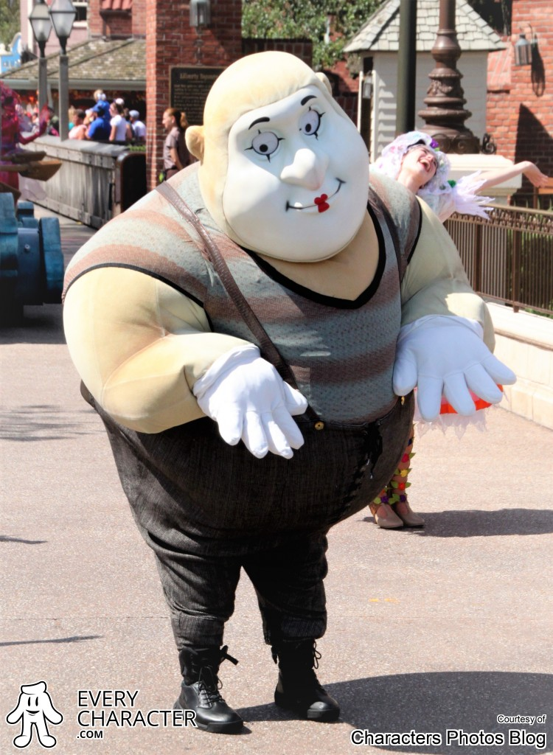
I have a dream…
All advisors on campus will have access to electronic folders in their department
  Contact Danny Gourley Fischer if do not have access to your department files/Sharepoint
All Advisors on campus will visit the Academic Advising Website and access the Campus Advising Network Website to review the recourses available in the Resources for Advisors tab
All advisors on campus will utilize Advising Worksheets and save a PDF in the electronic file
  When EAB Navigate is fully implemented, saving PDF of advising worksheets may not be necessary

