Slide 1


McGraw Hill ALEKS PPL
Placement, Preparation & Learning
Math placement assessment procedures for EIU
Testing and Evaluation Operations (TEO).

Slide 2
ALEKS is an artificially intelligent learning and assessment system that has been used by over 25 million students for Math, Chemistry, Statistics and Accounting. After quickly and accurately determining each student's precise knowledge of a subject, ALEKS helps the student work on the topics they are ready to learn. ALEKS intelligence, content and software are unique and proprietary; they have been developed together, and work in unison. ALEKS digital content provides comprehensive course coverage. Students who do their ALEKS assignments are successful in their course!
ALEKS is the most effective adaptive learning program.
ALEKS is a research-based, online learning program that offers course products for Math, Chemistry, Statistics, and more. Rooted in 20 years of research and analytics.
ALEKS is a proven, online learning platform that helps educators and parents understand each student's knowledge and learning progress in depth, and provides the individual support required for every student to achieve mastery.
Information provided by: https://www.aleks.com/about_aleks

Slide 3
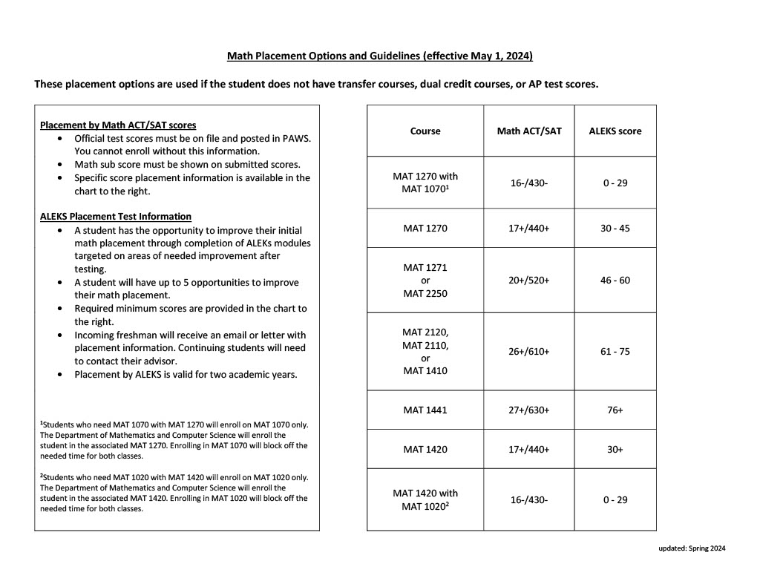
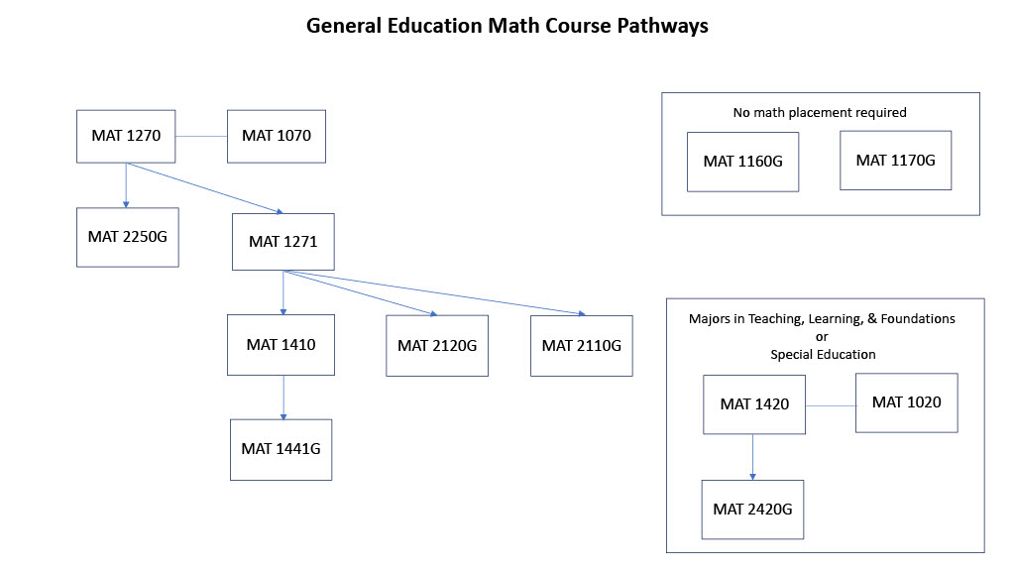
EIU Math Placement Guidelines
Information provided from: EIU MCS department website

Slide 4

Initial email sample/template sent by EIU Admissions Office.
​Dear $prospect_fname,
Welcome to EIU! With your advising appointment coming up soon, I wanted to encourage you to take some steps that may help you. You selected a major that has required math classes, but you don't necessarily have to take those classes, if you are able to show you have developed sufficient mathematical skills. Each major has different requirements, and your advisor will make sure you take as few math courses as needed for your major.
One way to demonstrate your math skills is to submit your SAT or ACT scores if you have never sent them to EIU, or updated scores if you have re-taken the test and got a higher score. Please note: your admission to EIU will not be affected by your SAT or ACT scores. Eastern does not require test scores for acceptance to the University, so it can only benefit you if you submit your test scores.
If you took the SAT, visit this page for instructions on how to send EIU your test scores: How to send your SAT report
If you took the ACT, visit this page instead: How to send your ACT report
If you did not take either the SAT or ACT, or you are unable to send us your scores, you may be required to take the ALEKS placement test. This test can be taken entirely online and can be sent to your advisor at EIU instantly. This exam must be finalized before your appointment with your advisor. The score on your ALEKS placement exam will aid your advisor in placing you into the perfect math course for you.
For more information on the ALEKS placement test, visit this page: www.aleks.com. Please follow the instructions to create your own personalized ALEKS placement account for EIU, using the "Sign Up" link at the top right of screen. Remember to save your login information! You will need to use this for your account access in the future to take additional placement exams and/or study with the preparation and learning tools within the program. Your account will be active for one year, and you have the opportunity to work with the tutorial lessons to study and prepare for your next placement exam. You can even take the test multiple times, and we will accept your highest score.
Your class or cohort code is: 6LXGC-WKMJW. Please use this code when registering your account with EIU.
Again, while sending your SAT or ACT scores is optional, it will help your advisor ensure that you take as few math courses as you need, and ultimately that you're well-equipped to succeed in your major and future career.
Please let me know if you have any questions. I'd be happy to help.
Sincerely,
Sent to qualifying incoming freshmen before their orientation visits based on chosen major of study.
Reminder emails are sent periodically through EIU PRM system to remind students that have not yet completed the assessment before their orientation visits.

Slide 5

Orientation Day
If the math placement assessment is not complete before attending orientation on campus, the student will attend the math placement session in the TEO Testing Lab in McAfee Gym to take the assessment.
The assessment is administered and managed by TEO staff members.
Scores from this assessment are immediately entered in SOATEST in Banner for quick Academic Advisor viewing before meeting with the student to plan a course schedule.
Testing Lab #1 – McAfee Gym

Slide 6

Assessment Administration Procedure for Academic Advisor Referrals
Academic Advisor to send referral email to Carrie Gossett – cegossett@eiu.edu and cc Brandy Verdin – bkverdin@eiu.edu .
Information requested in email for referral:
  Student Name
  Student E#
  Date and/or timeframe needed for assessment to be administered
  Distinguish if for an initial assessment or additional (2,3,4,5) in series - after the tutorial session within ALEKS.
  Any additional student information deemed necessary for assessment session
  Advisor name and information (email signature)
TEO will send the student an email and cc the advisor with the assessment invitation information.
TEO will manage the appointment scheduling for in person or remote session administration.
TEO staff will monitor the administration sessions.
TEO will enter the student scores in SOATEST in Banner for Advisor viewing.
TEO will notify the Academic Advisor of the new ALEKS score for the student.
TEO will manage any additional emails/scheduling (if needed) for the tutorial session and/or additional assessments.
TEO will notify the Academic Advisor if any additional scores have been updated in SOATEST in Banner.

Slide 7
ALEKS Banner Codes for SOATEST
Test Code | Description | Score | Courses
ALEKS1 | Math with lab | 0-29 | MAT 1270 w/MAT 1070 OR MAT 1420 w/MAT 1020
ALEKS2 | Math without lab | 30-45 | MAT 1270 OR MAT 1420
ALEKS3 | Algebra and stats | 46-60 | MAT 2250G OR MAT 1271 OR MAT 1270 OR MAT 1420
ALEKS4 | Finite and Business Calc | 61-75 | MAT 2120 OR MAT 2110 OR MAT 1410 OR MAT 2250G OR MAT 1271 OR MAT 1270 OR MAT 1420
ALEKS5 | Calculus | 76-100 | MAT 1441 OR MAT 2120 OR MAT 2110 OR MAT 1410 OR MAT 2250G OR MAT 1271 OR MAT 1270 OR MAT 1420

Slide 8
FA24 EIU ALEKS Math Placement Assessment Breakdowns

Slide 9
Prep and Learning Modules – Tutorial Sessions
EIU Prep and Learning Modules (5)
  Prep for Beginning Algebra
  Prep for Intermediate Algebra
  Prep for College Algebra
  Prep for Pre-Calculus
  Prep for Calculus
The ALEKS program automatically assigns students to a Prep and Learning Module based on their most recent placement assessment results.
Time required in each learning module before moving on to next level assessment
  Before starting 2nd assessment – 5 hours
  Before starting 3rd assessment – 5 hours
  Before starting 4th assessment – 3 hours
  Before starting 5th assessment – 3 hours
ALEKS will send automated email reminders to students to motivate them to work in the learning modules and continue with the next level assessment.

Slide 11
Testing and Evaluation Operations
McAfee Gym Building – Suite 2000
Phone – 217-581-6696
Carrie Gossett, Director
cegossett@eiu.edu
Brandy Verdin, Office Manager
bkverdin@eiu.edu
Debra Coartney, Testing Coordinator
djcoartney@eiu.edu

